Slide 1
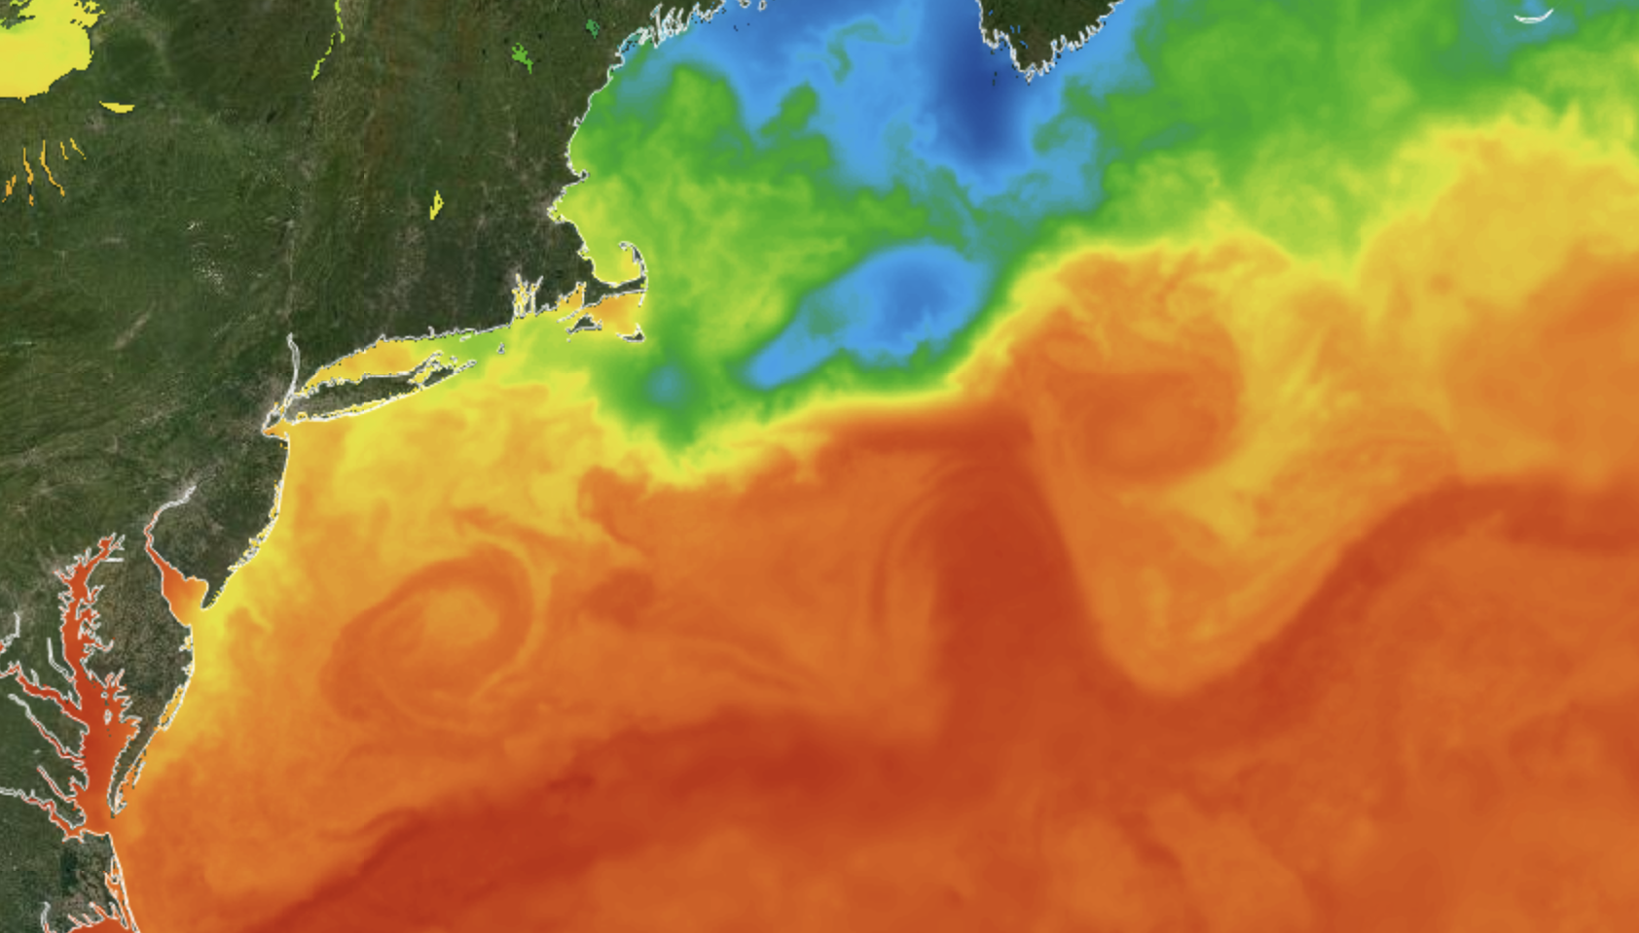



Anomalous intrusions of warm core ring water onto the Mid-Atlantic Bight shelf alleviate acidification but increase warming during summer 2021
Grace Saba, Travis Miles
Avijit Gangopadhyay, Adrienne Silver
Glen Gawarkiewicz

Slide 2
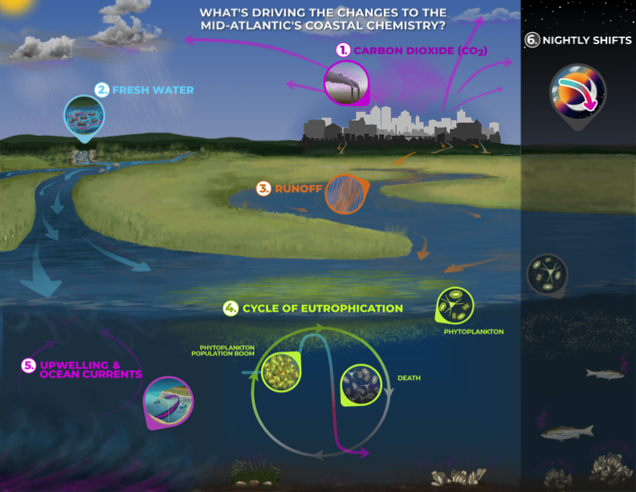
Coastal & Ocean Acidification in the Mid-Atlantic
High variability and complexity in coastal shelf systems
NOAA Sea Grant

Slide 3
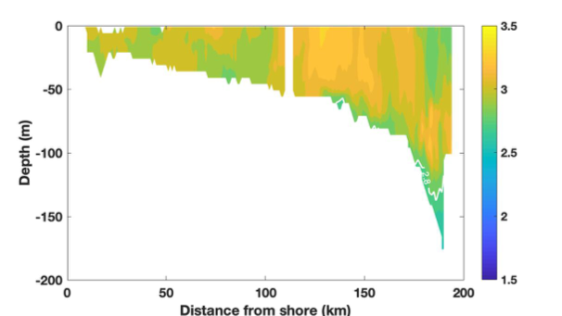
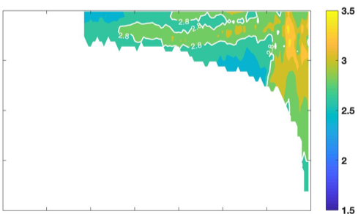
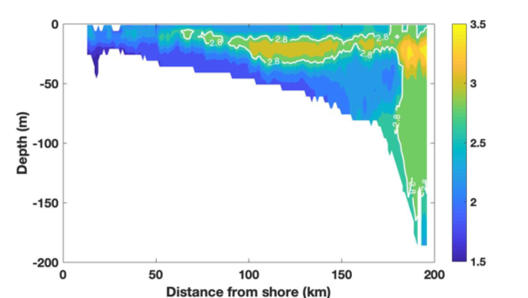
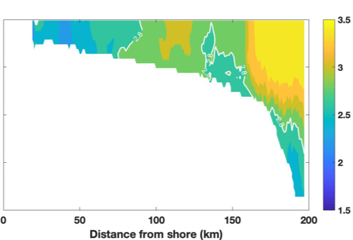
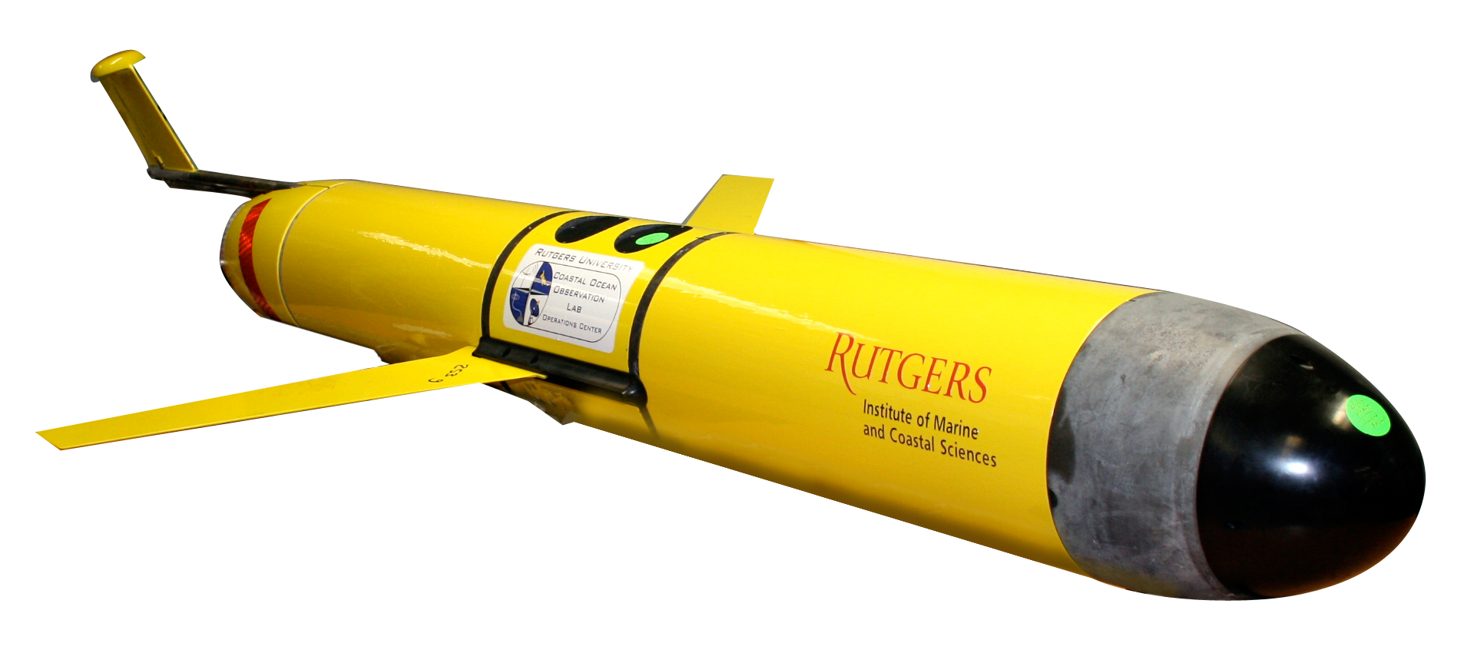
Seasonal glider-derived ΩArag on MAB Shelf
pH gliders have operated from 2018-present
Recent & ongoing missions focus on seasonal dynamics and expanded throughout MAB & Gulf of Maine
Winter
Spring
Atlantic Surfclam
Spisula solidissima
Summer
Atlantic Sea Scallop
Placopecten magellanicus
Fall
Modified from
Wright-Fairbanks et al. 2020

Slide 4
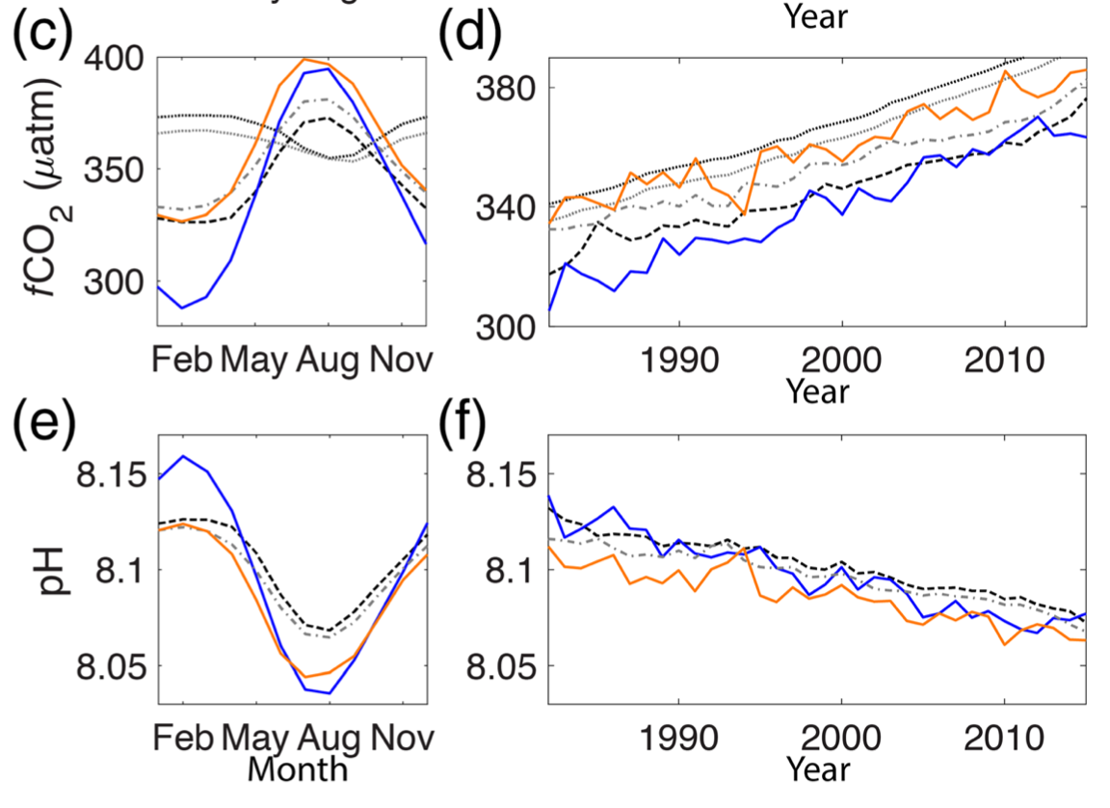
Trends Over Time (U.S. East Coast): 1982-2015
18 µatm decade⁻¹
-0.019 decade⁻¹
Xu et al. 2020

Slide 5
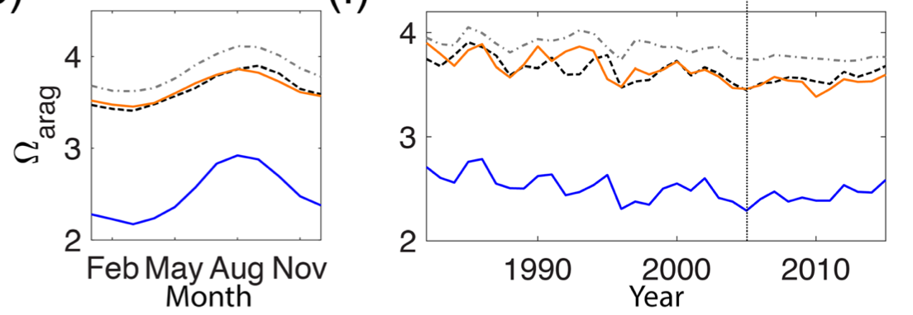
Trends Over Time (U.S. East Coast): 1982-2015
18 µatm decade⁻¹
-0.125 decade⁻¹
stagnant
Stagnation of Ω perhaps linked to intrusion of high TA/Ω Gulf Stream water mass with northward shift of Gulf Stream north wall
-0.019 decade⁻¹
Xu et al. 2020

Slide 6
Water Sources with Variable Ω in Mid-Atlantic
Cold, higher CO₂, weakly buffered Labrador Sea Slope Water
=10 m
Ω
Warm, salty, well buffered Gulf Stream
Wanninkhof et al. 2015

Slide 7
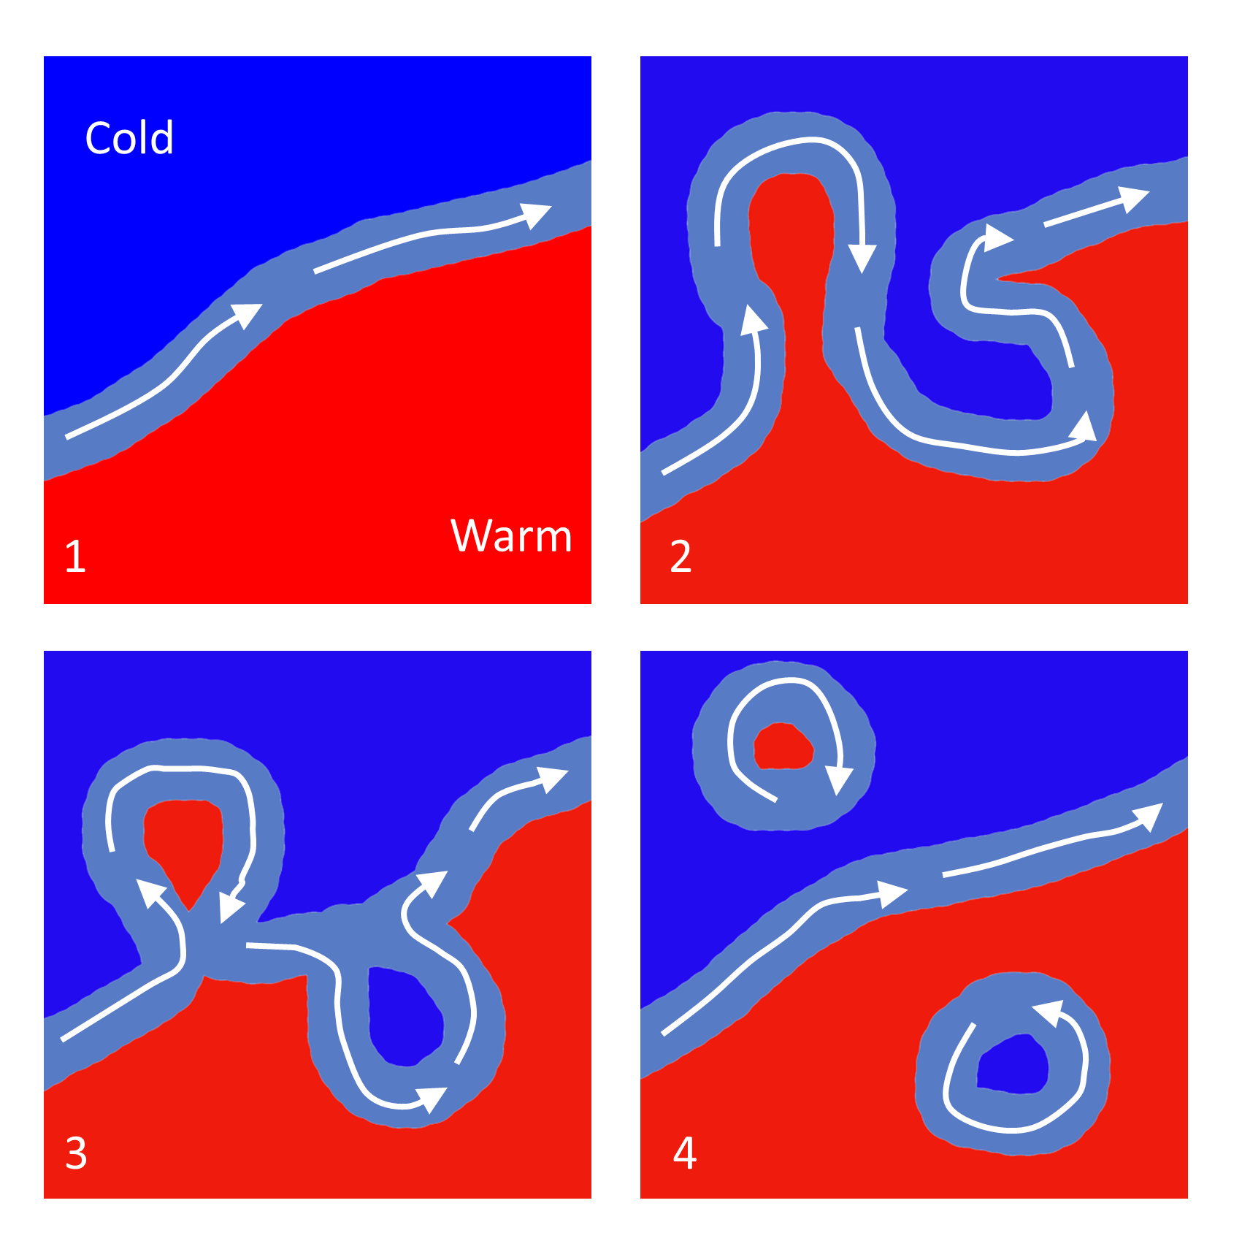
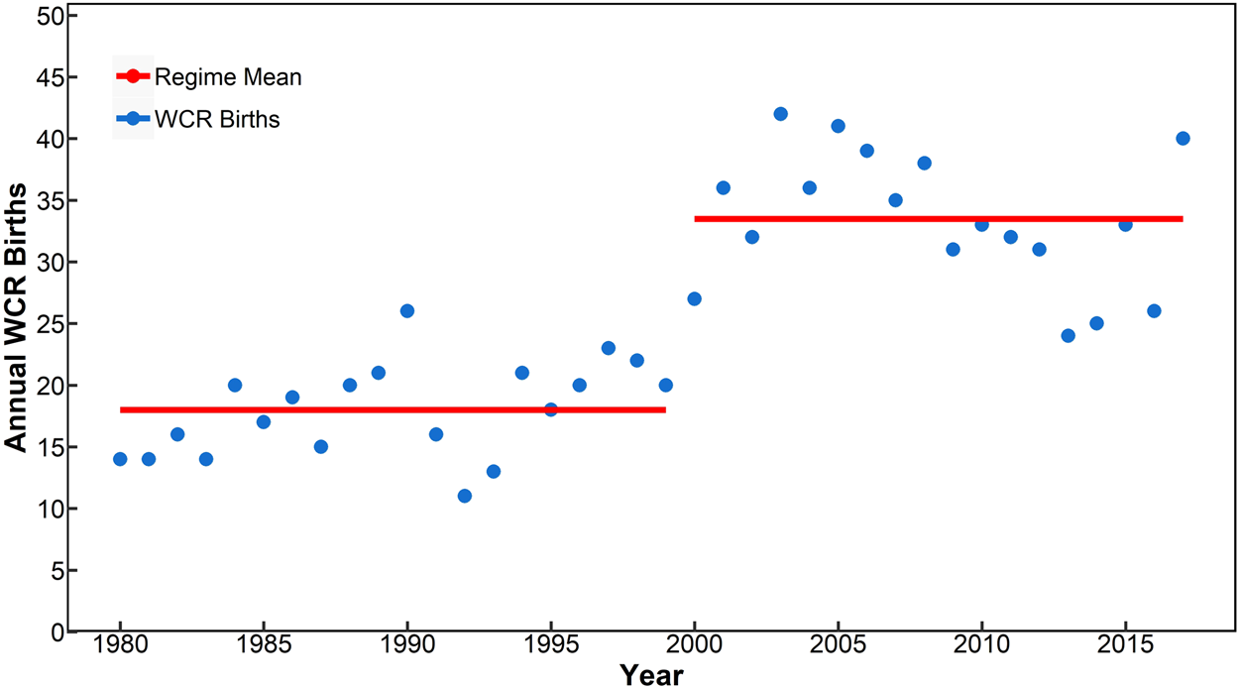
Increased Warm Core Ring Activity in the NW Atlantic
modified from Webb, 2019
Increased WCRs associated with:
  increased instability of the Gulf Stream
  warming of the slope sea (north of the Gulf Stream wall)
Gulf Stream
Gangopadhyay et al., 2019

Slide 8
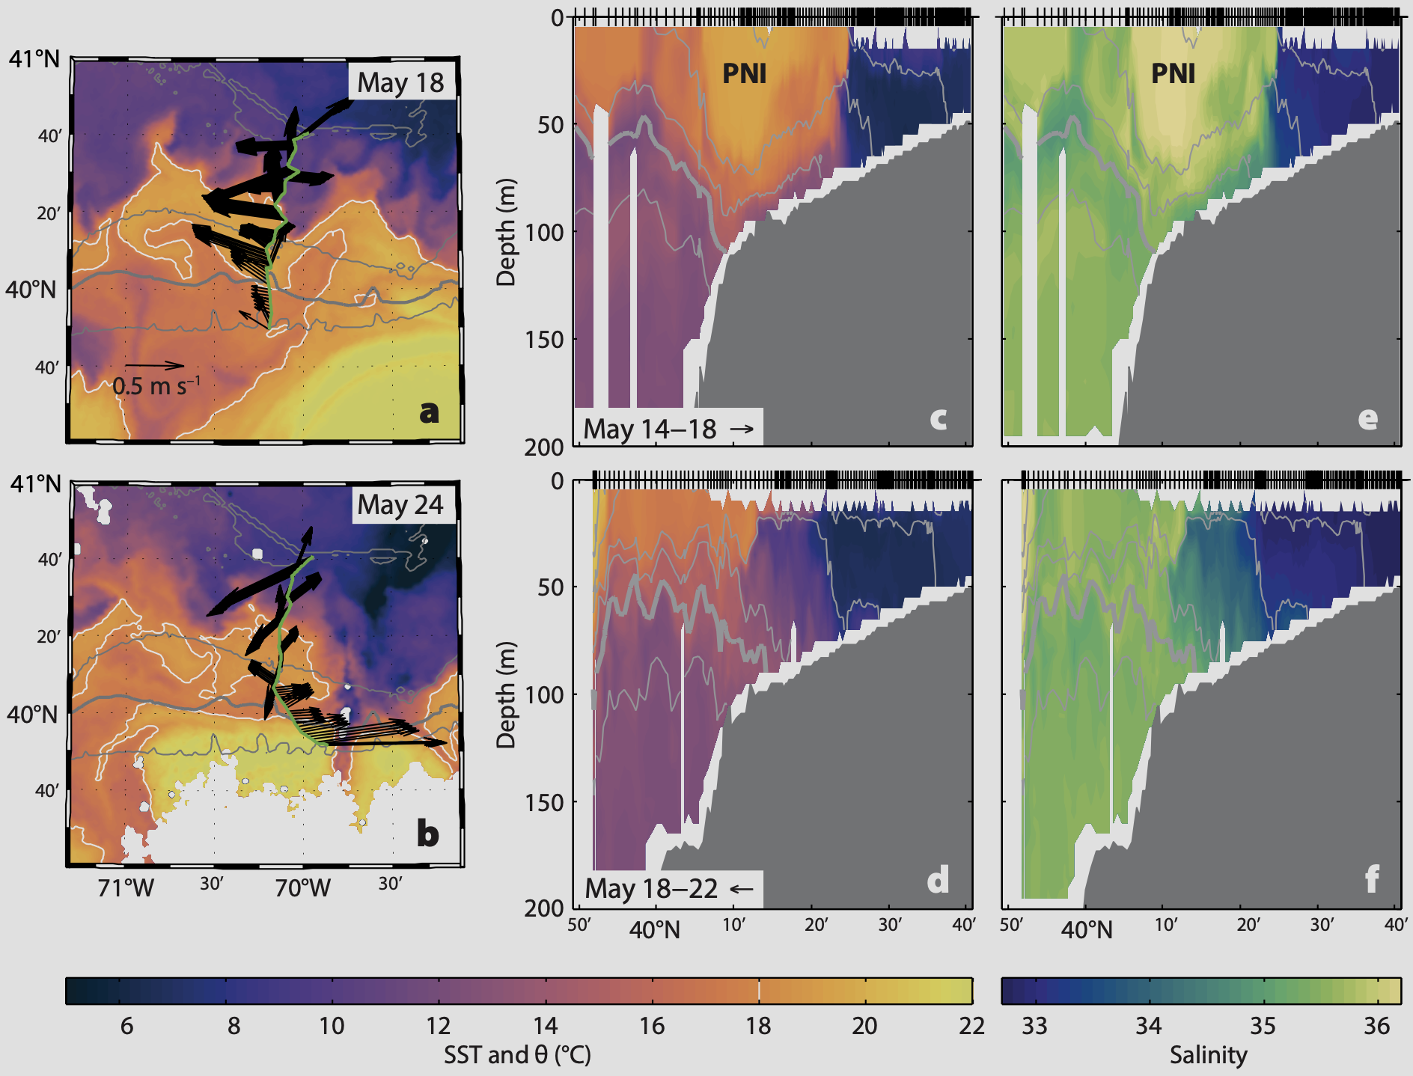
More Frequent Warm, Salty Intrusions on the Shelf
Gawarkiewicz et al., 2018

Slide 9
More Frequent Warm, Salty Intrusions on the Shelf
Intrusions:
  Occurring more frequently
  Penetrating further onshore
  Contribute to marine heat waves
  Drivers = encroaching Gulf Stream northern wall & increase in WCRs since 2000
Gawarkiewicz et al., 2018

Slide 10
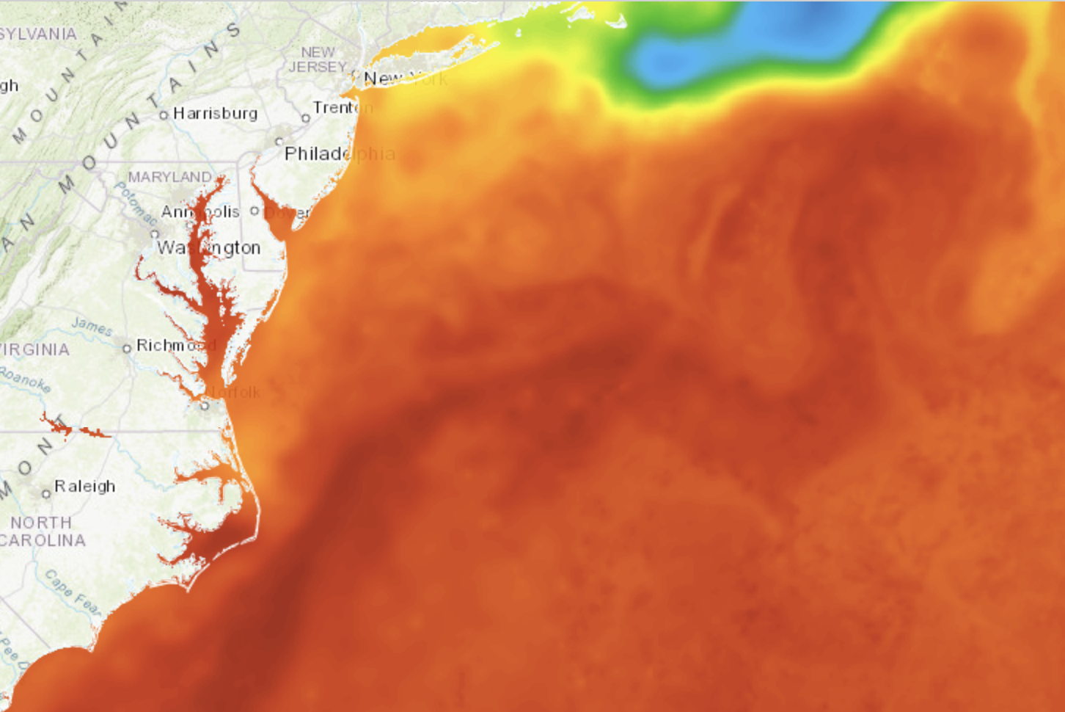
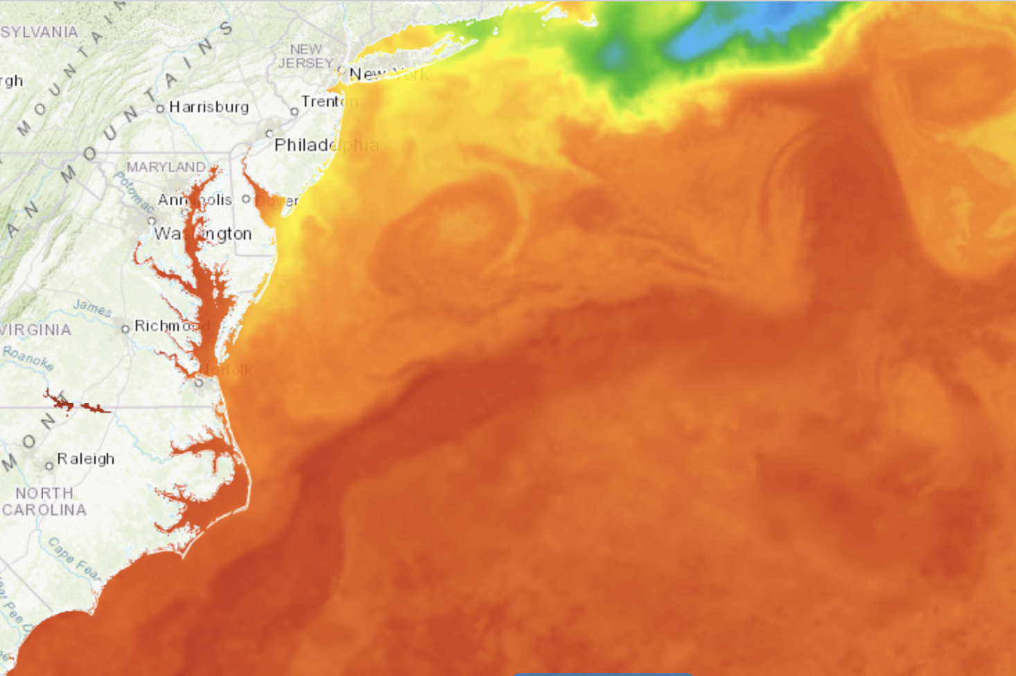
How do WCRs and associated intrusions of this water mass
impact carbonate chemistry on the MAB shelf?
2019
2021
MARACOOS OceansMap: NASA GHRSST Level 4 sea surface temperature analysis

Slide 11
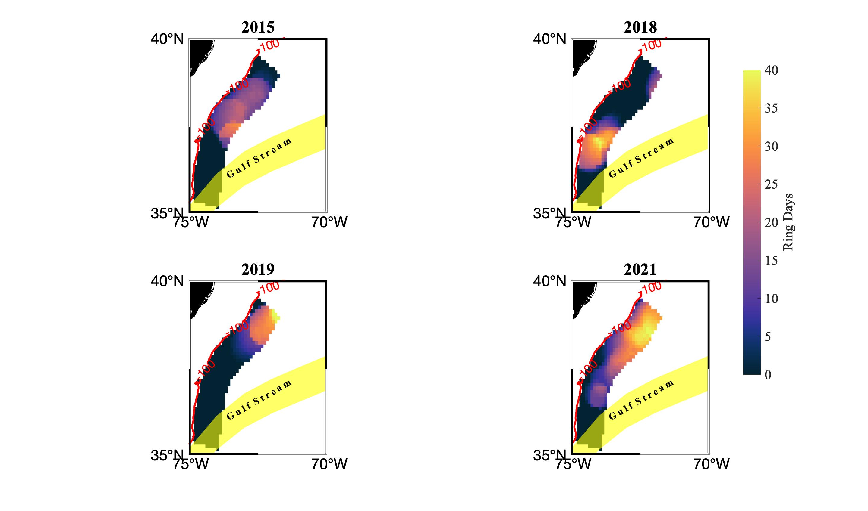
High WCR Activity in 2021
In July/August 2021, largest spatial area where WCRs were present along the shelf for more than 20 days
Largest area where WCRs were present for 40 of 62 days of July/August
Above average WCRs formed in January contributed to high number of rings near shelf break in June
(July-August)

Slide 12
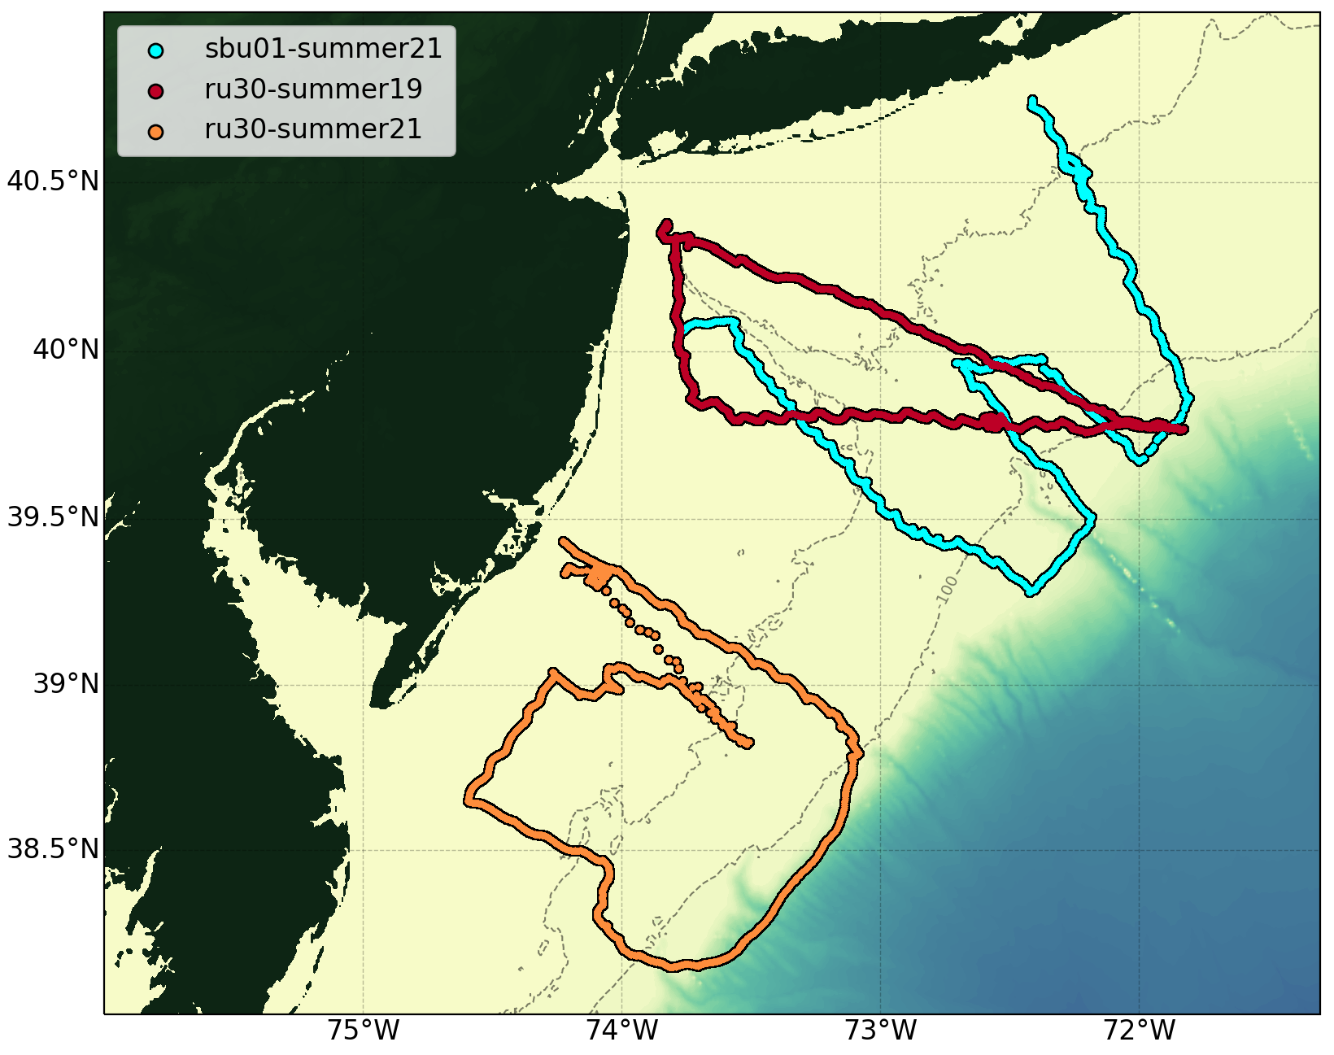
pH Glider Deployments: 2019, 2021
Gliders deployed with a suite of sensors:
  Deep-sea ISFET based pH
  CTD (Temperature, salinity, depth)
  Optode (dissolved oxygen)
  Optics (Chlorophyll, backscatter)
Total alkalinity estimated using conservative salinity-total alkalinity relationships
Carbonate system resolved, including ΩArag

Slide 13
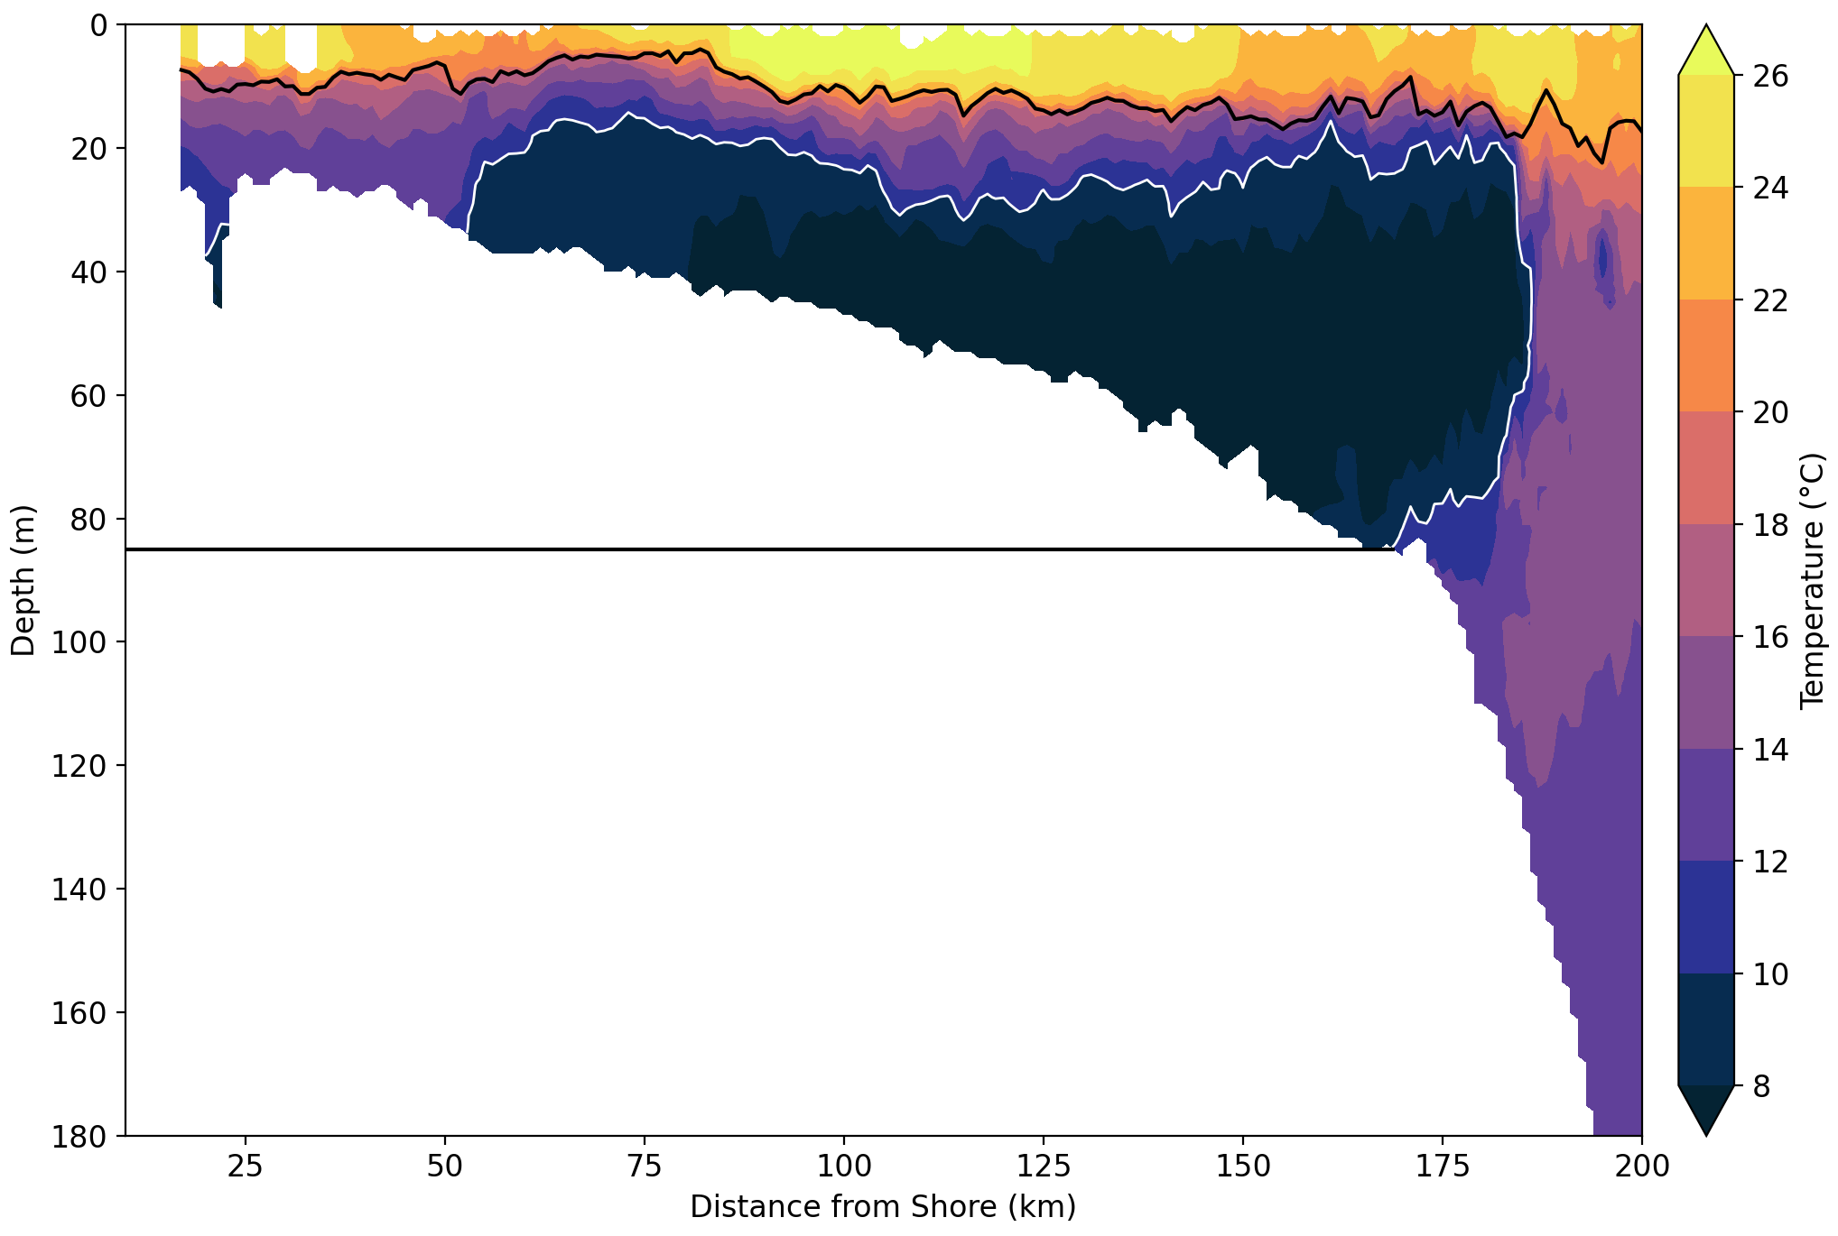
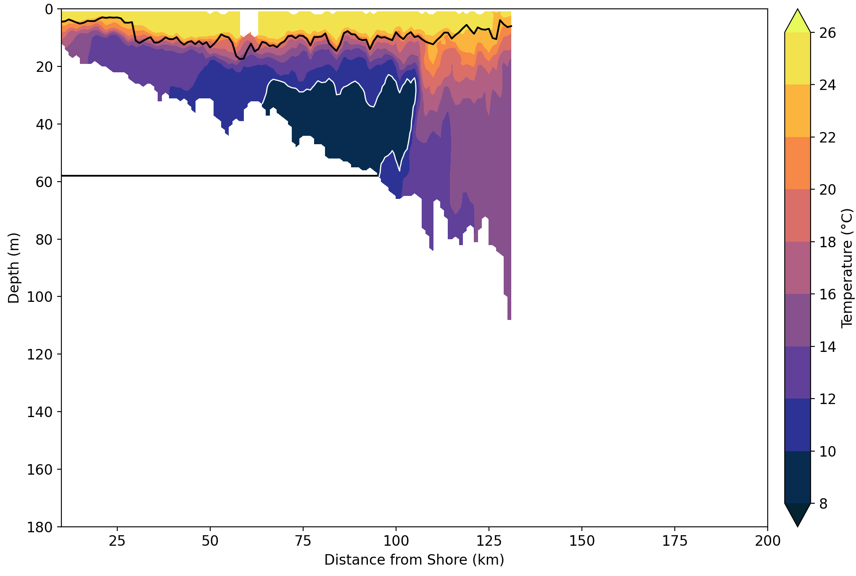
2021
2019
Horizontal extent of cold pool reached near the 90m isobath
S. MAB: Cold pool minimized; offshore boundary pushed to 60m isobath

Slide 14
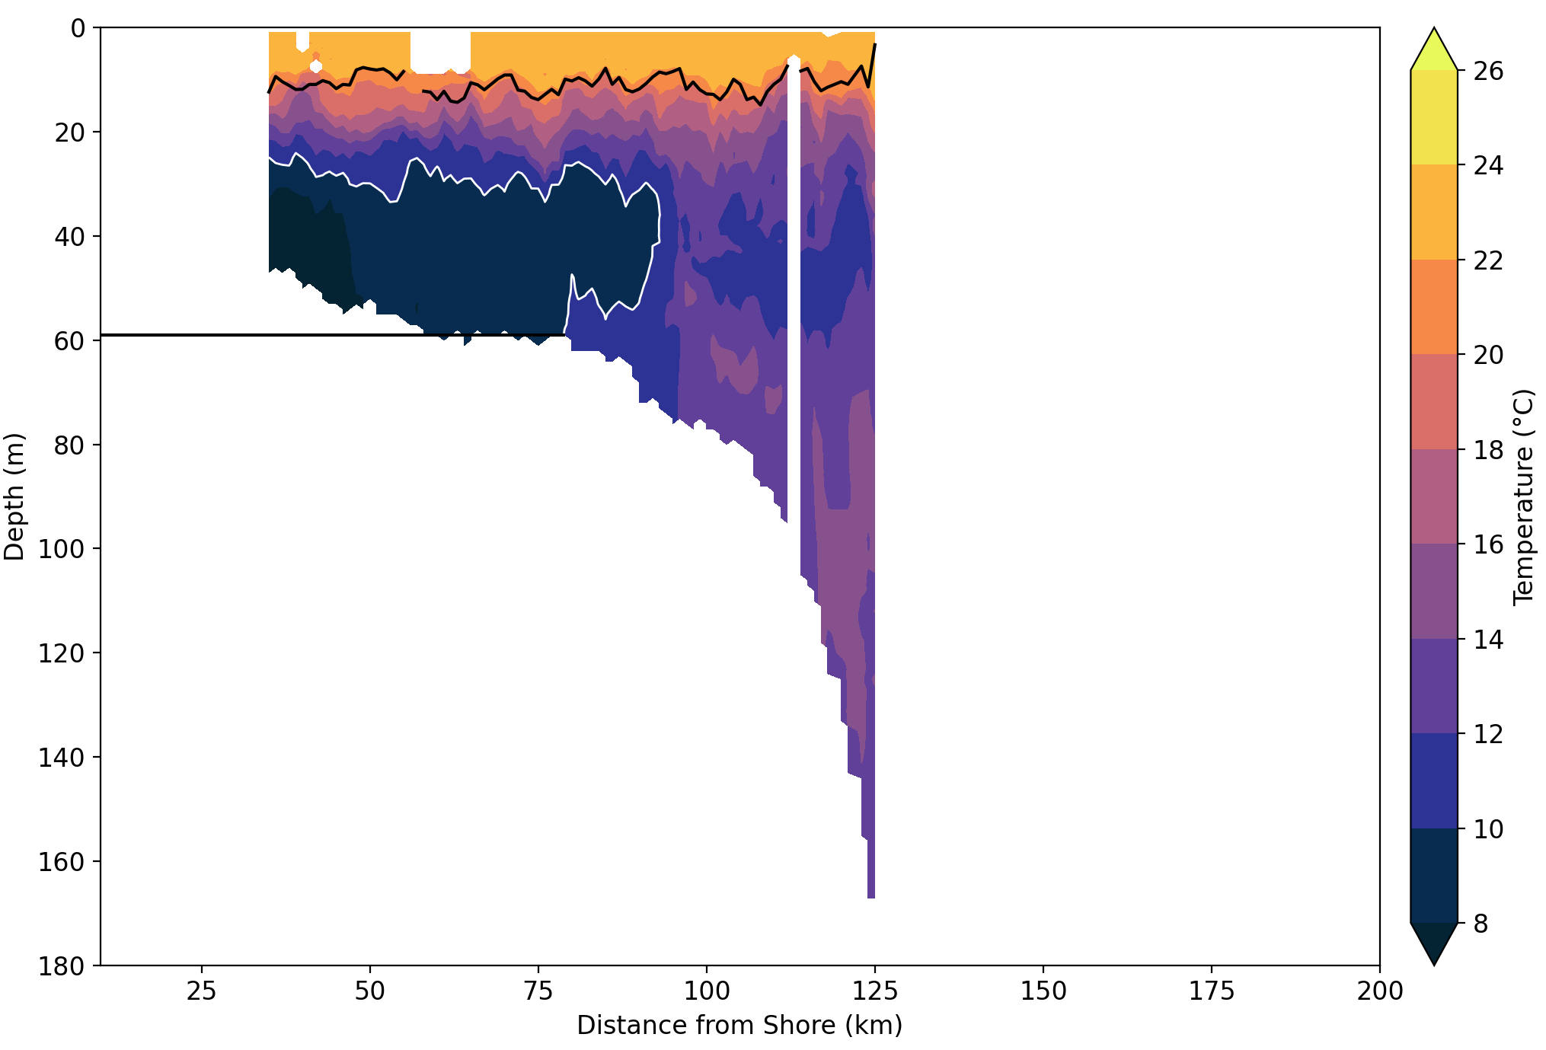
2021
2019
Horizontal extent of cold pool reached near the 90m isobath
N. MAB: Cold pool minimized; offshore boundary pushed to 60m isobath

Slide 15
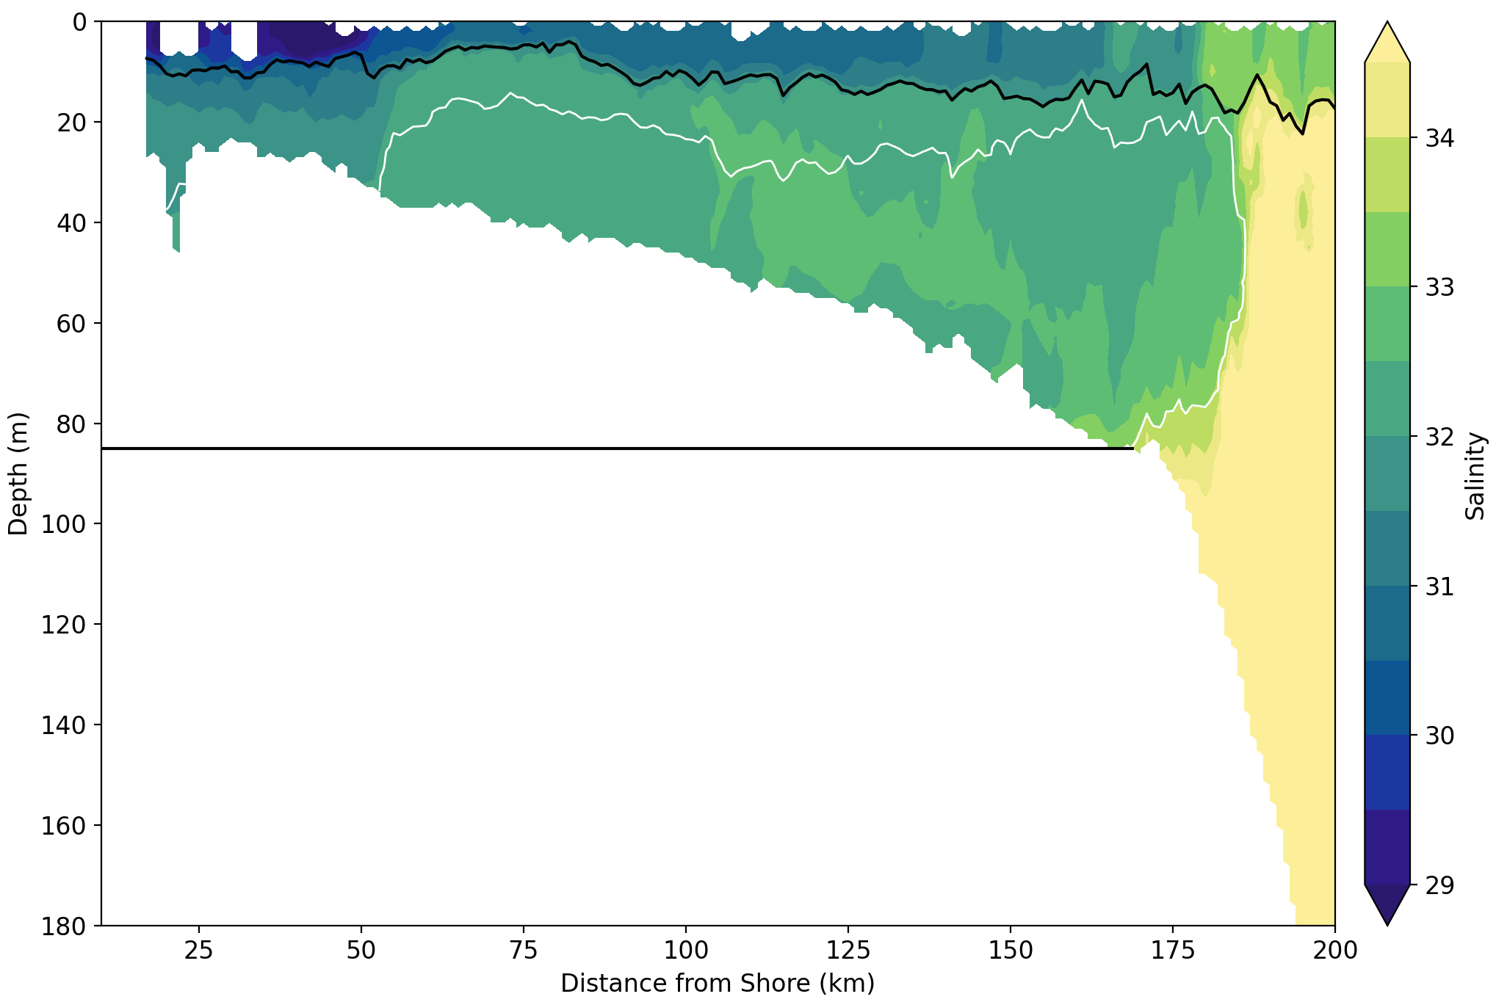
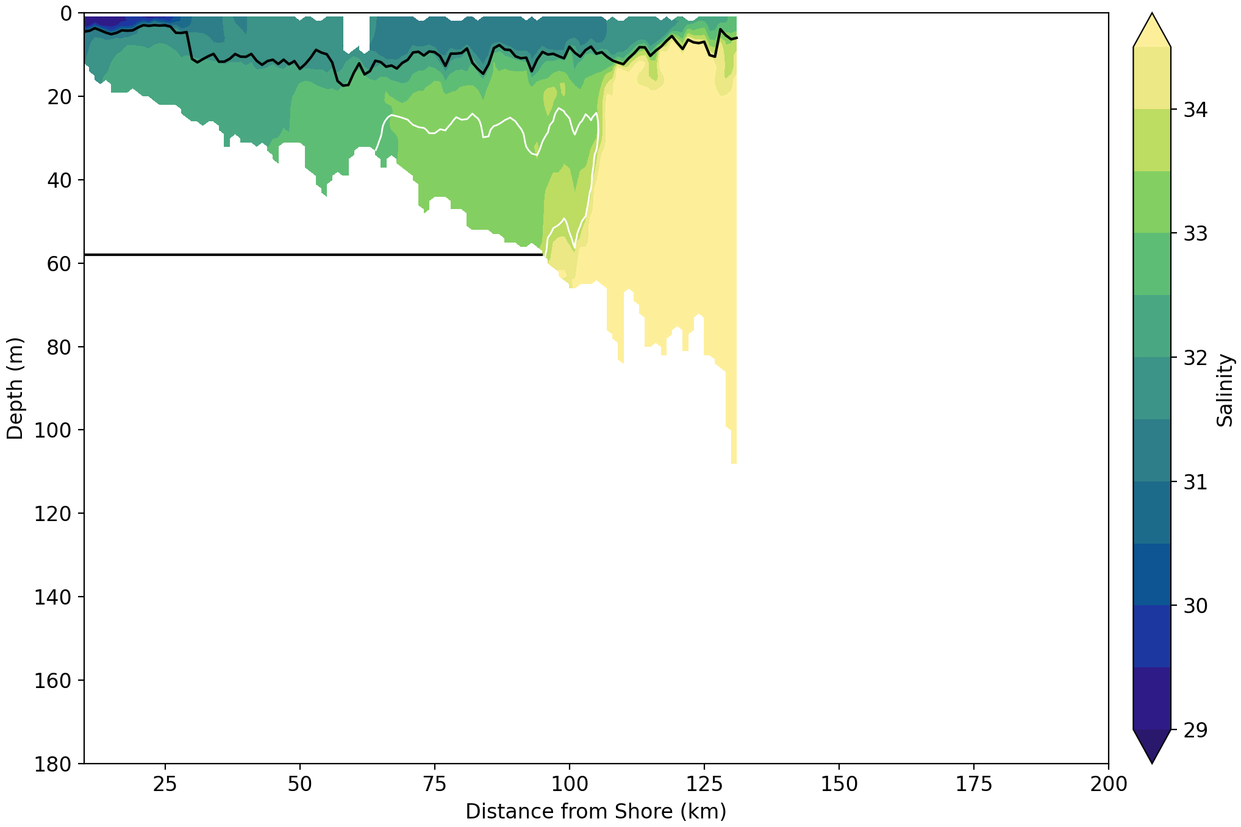
2021
2019
High salinity water (< 34.5 psu) limited to the shelf-slope
S. MAB: High salinity water pushed onto shelf to 60m isobath

Slide 16
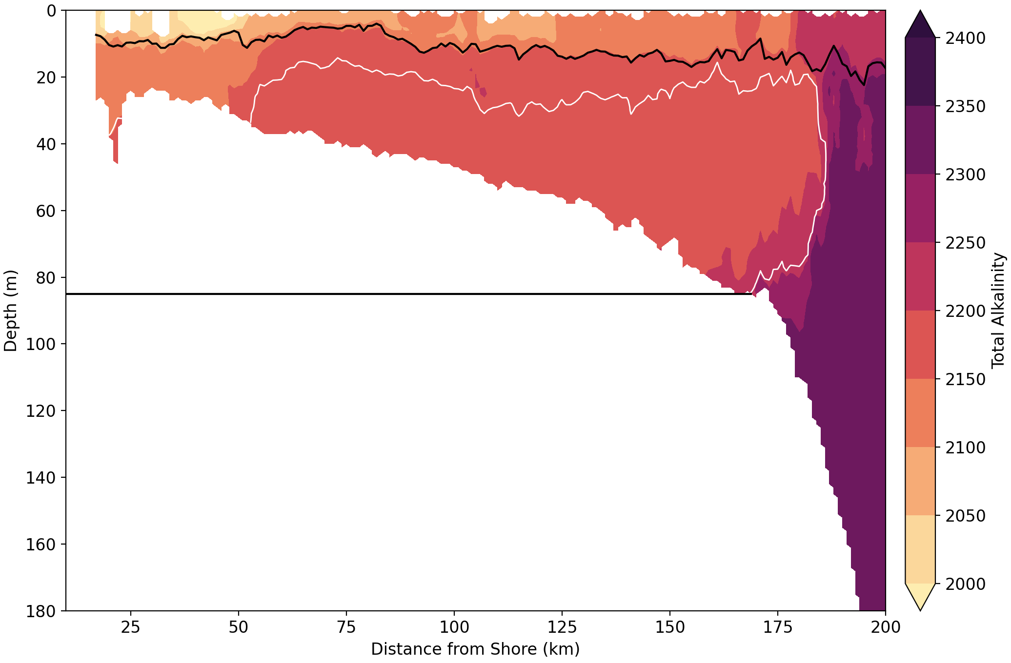
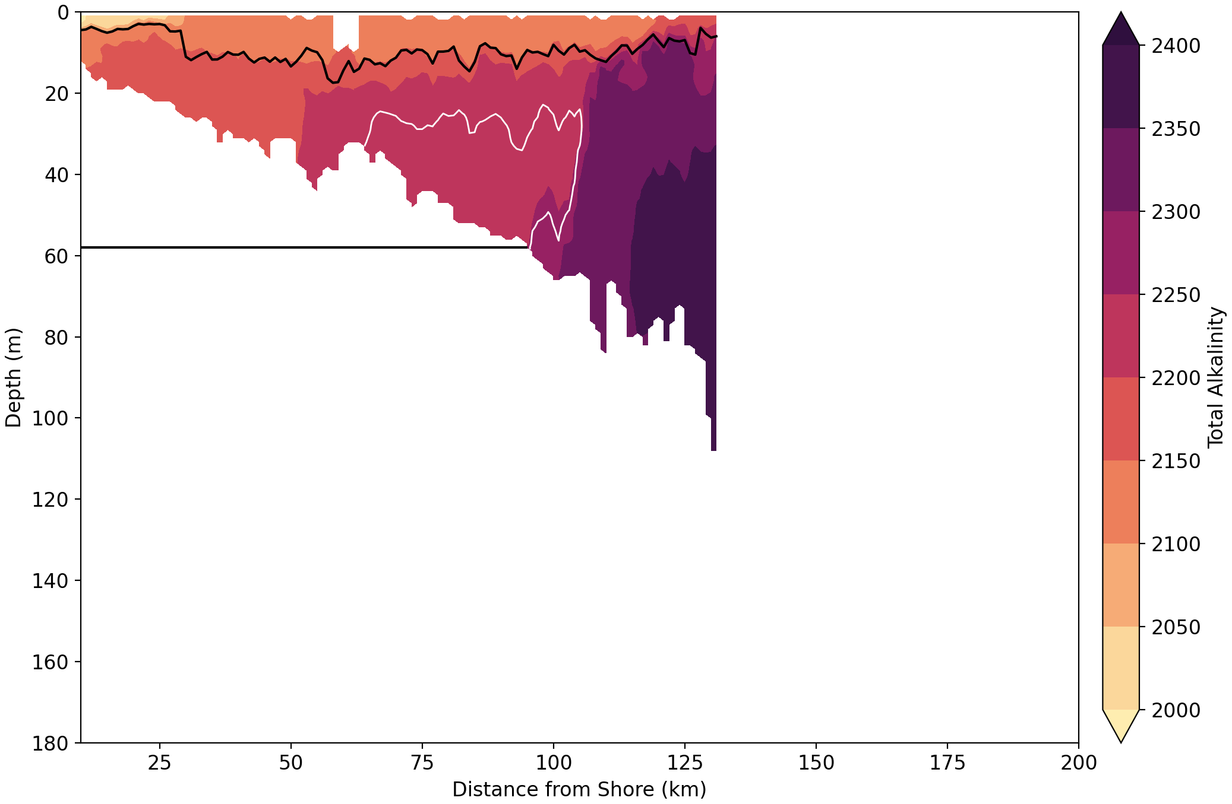
2021
2019
S. MAB: Highly alkaline water pushed onto shelf to 60m isobath, reaching 2400 µmol kg⁻¹ by the 80m isobath
Highly alkaline water (< 2300 µmol kg⁻¹) limited to the shelf-slope

Slide 17
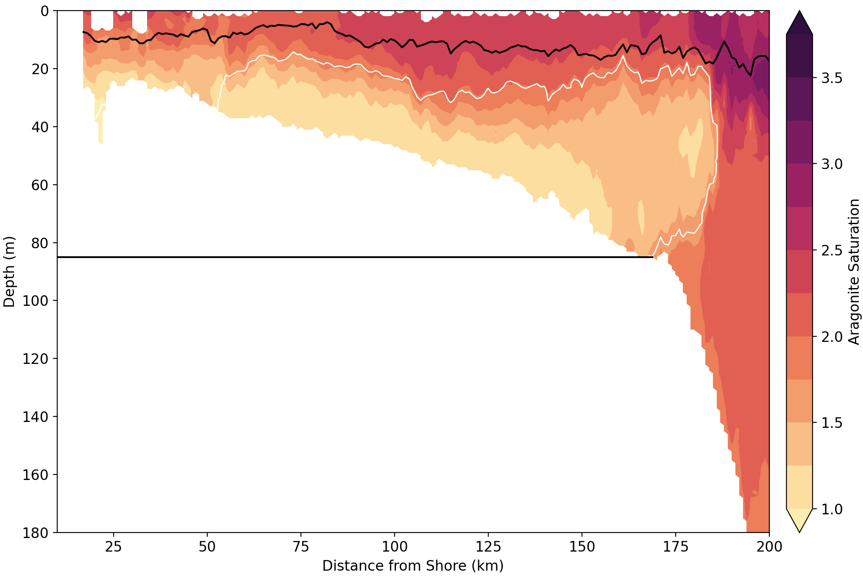
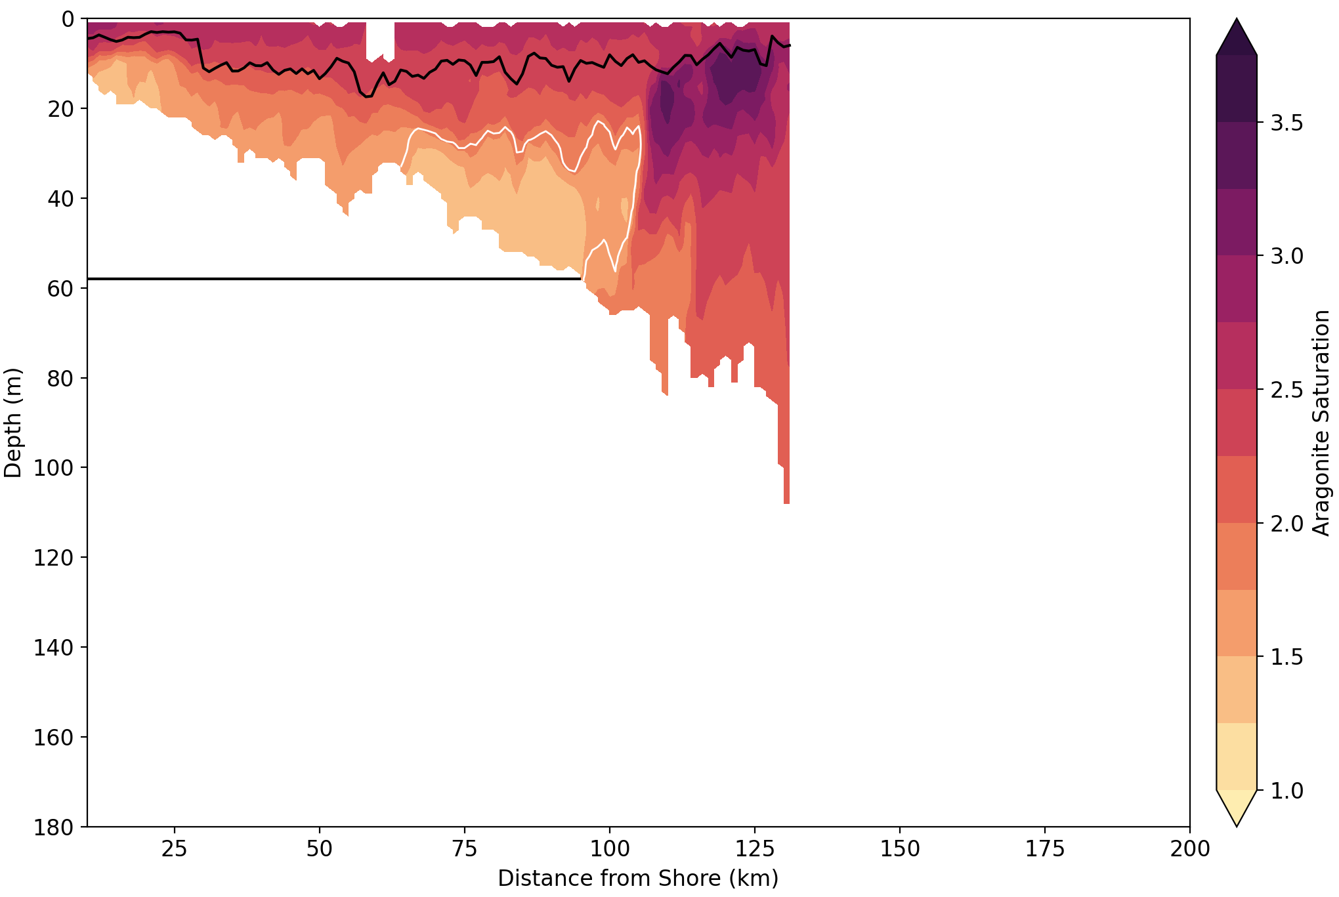
2021
2019
Ω between 0.9-1.5 in bottom waters to about the 90m isobath
S. MAB: Ω 1.8-3.0 in bottom waters beyond the 60m isobath

Slide 18
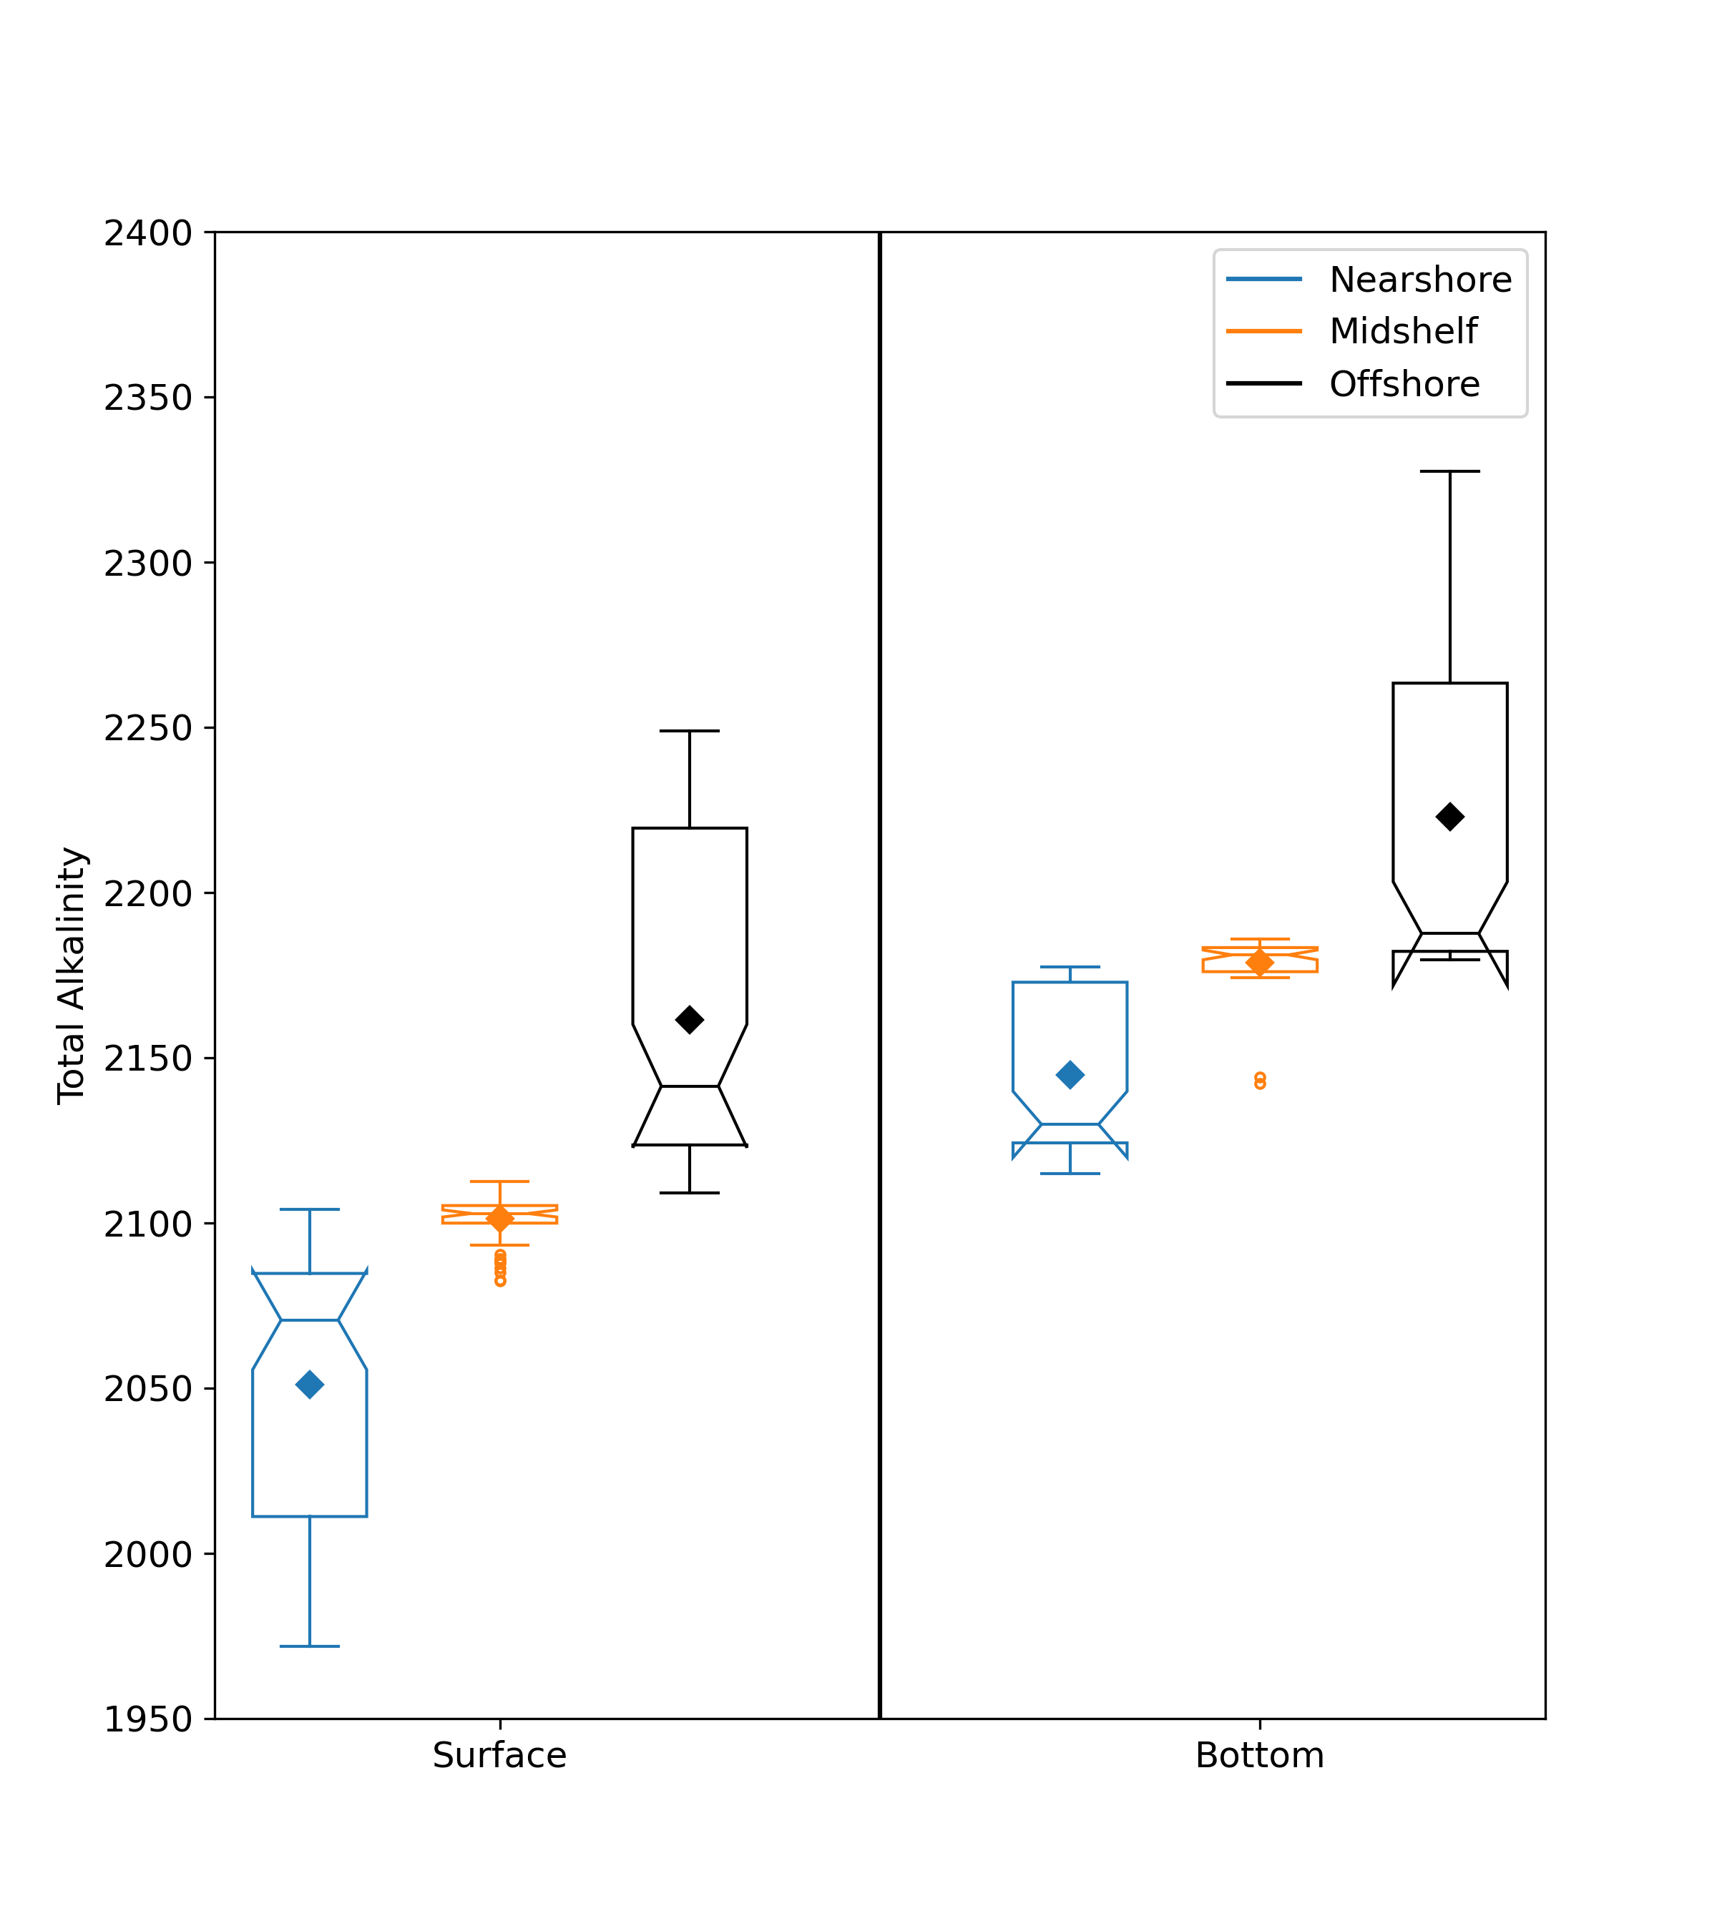
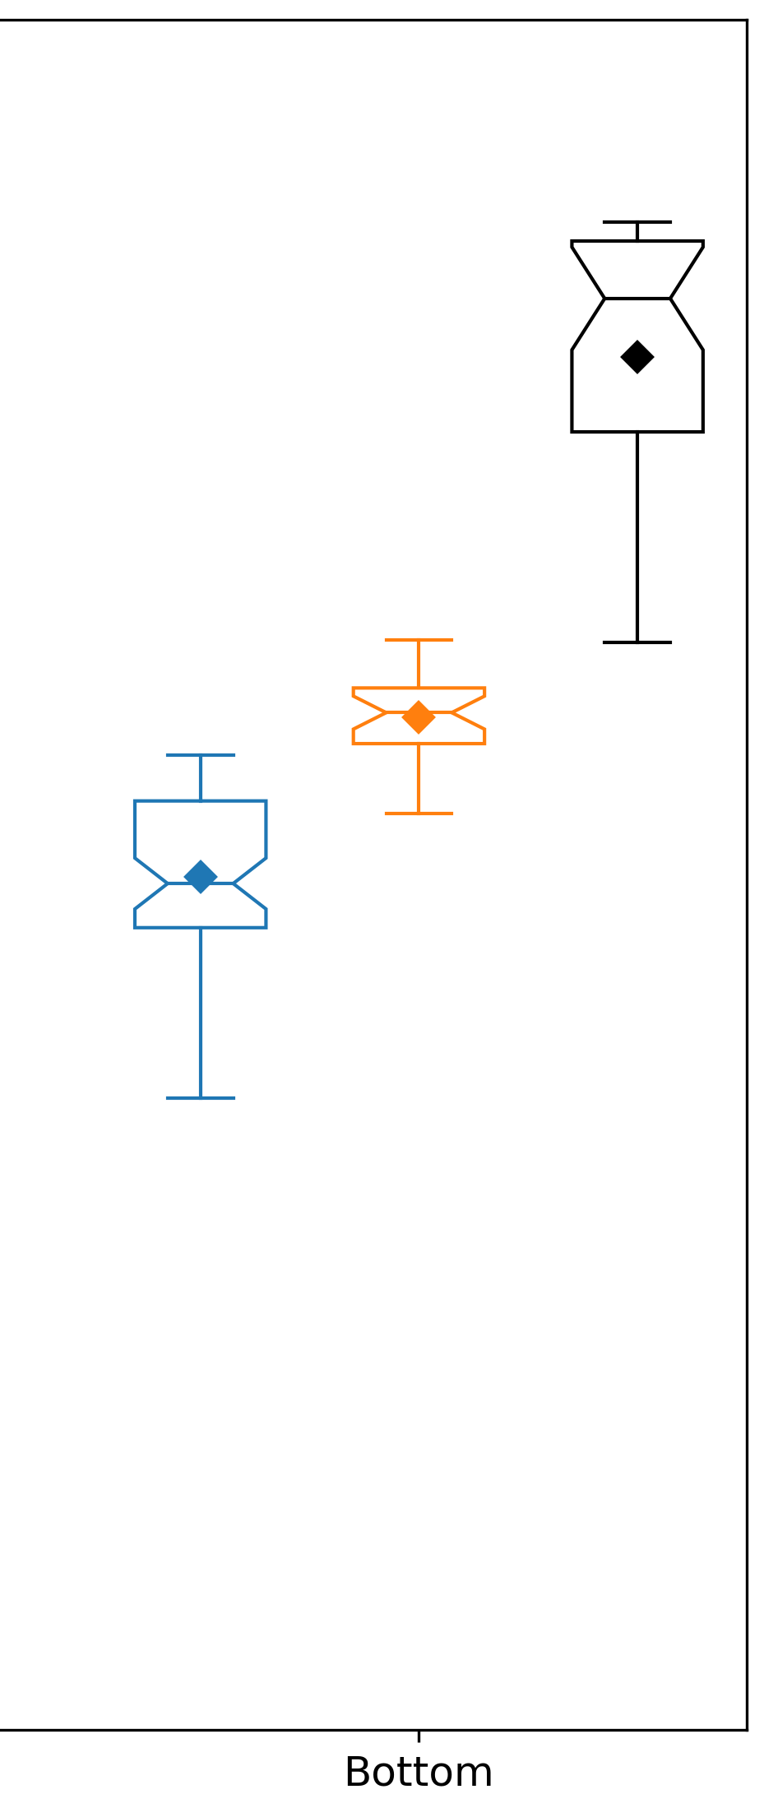
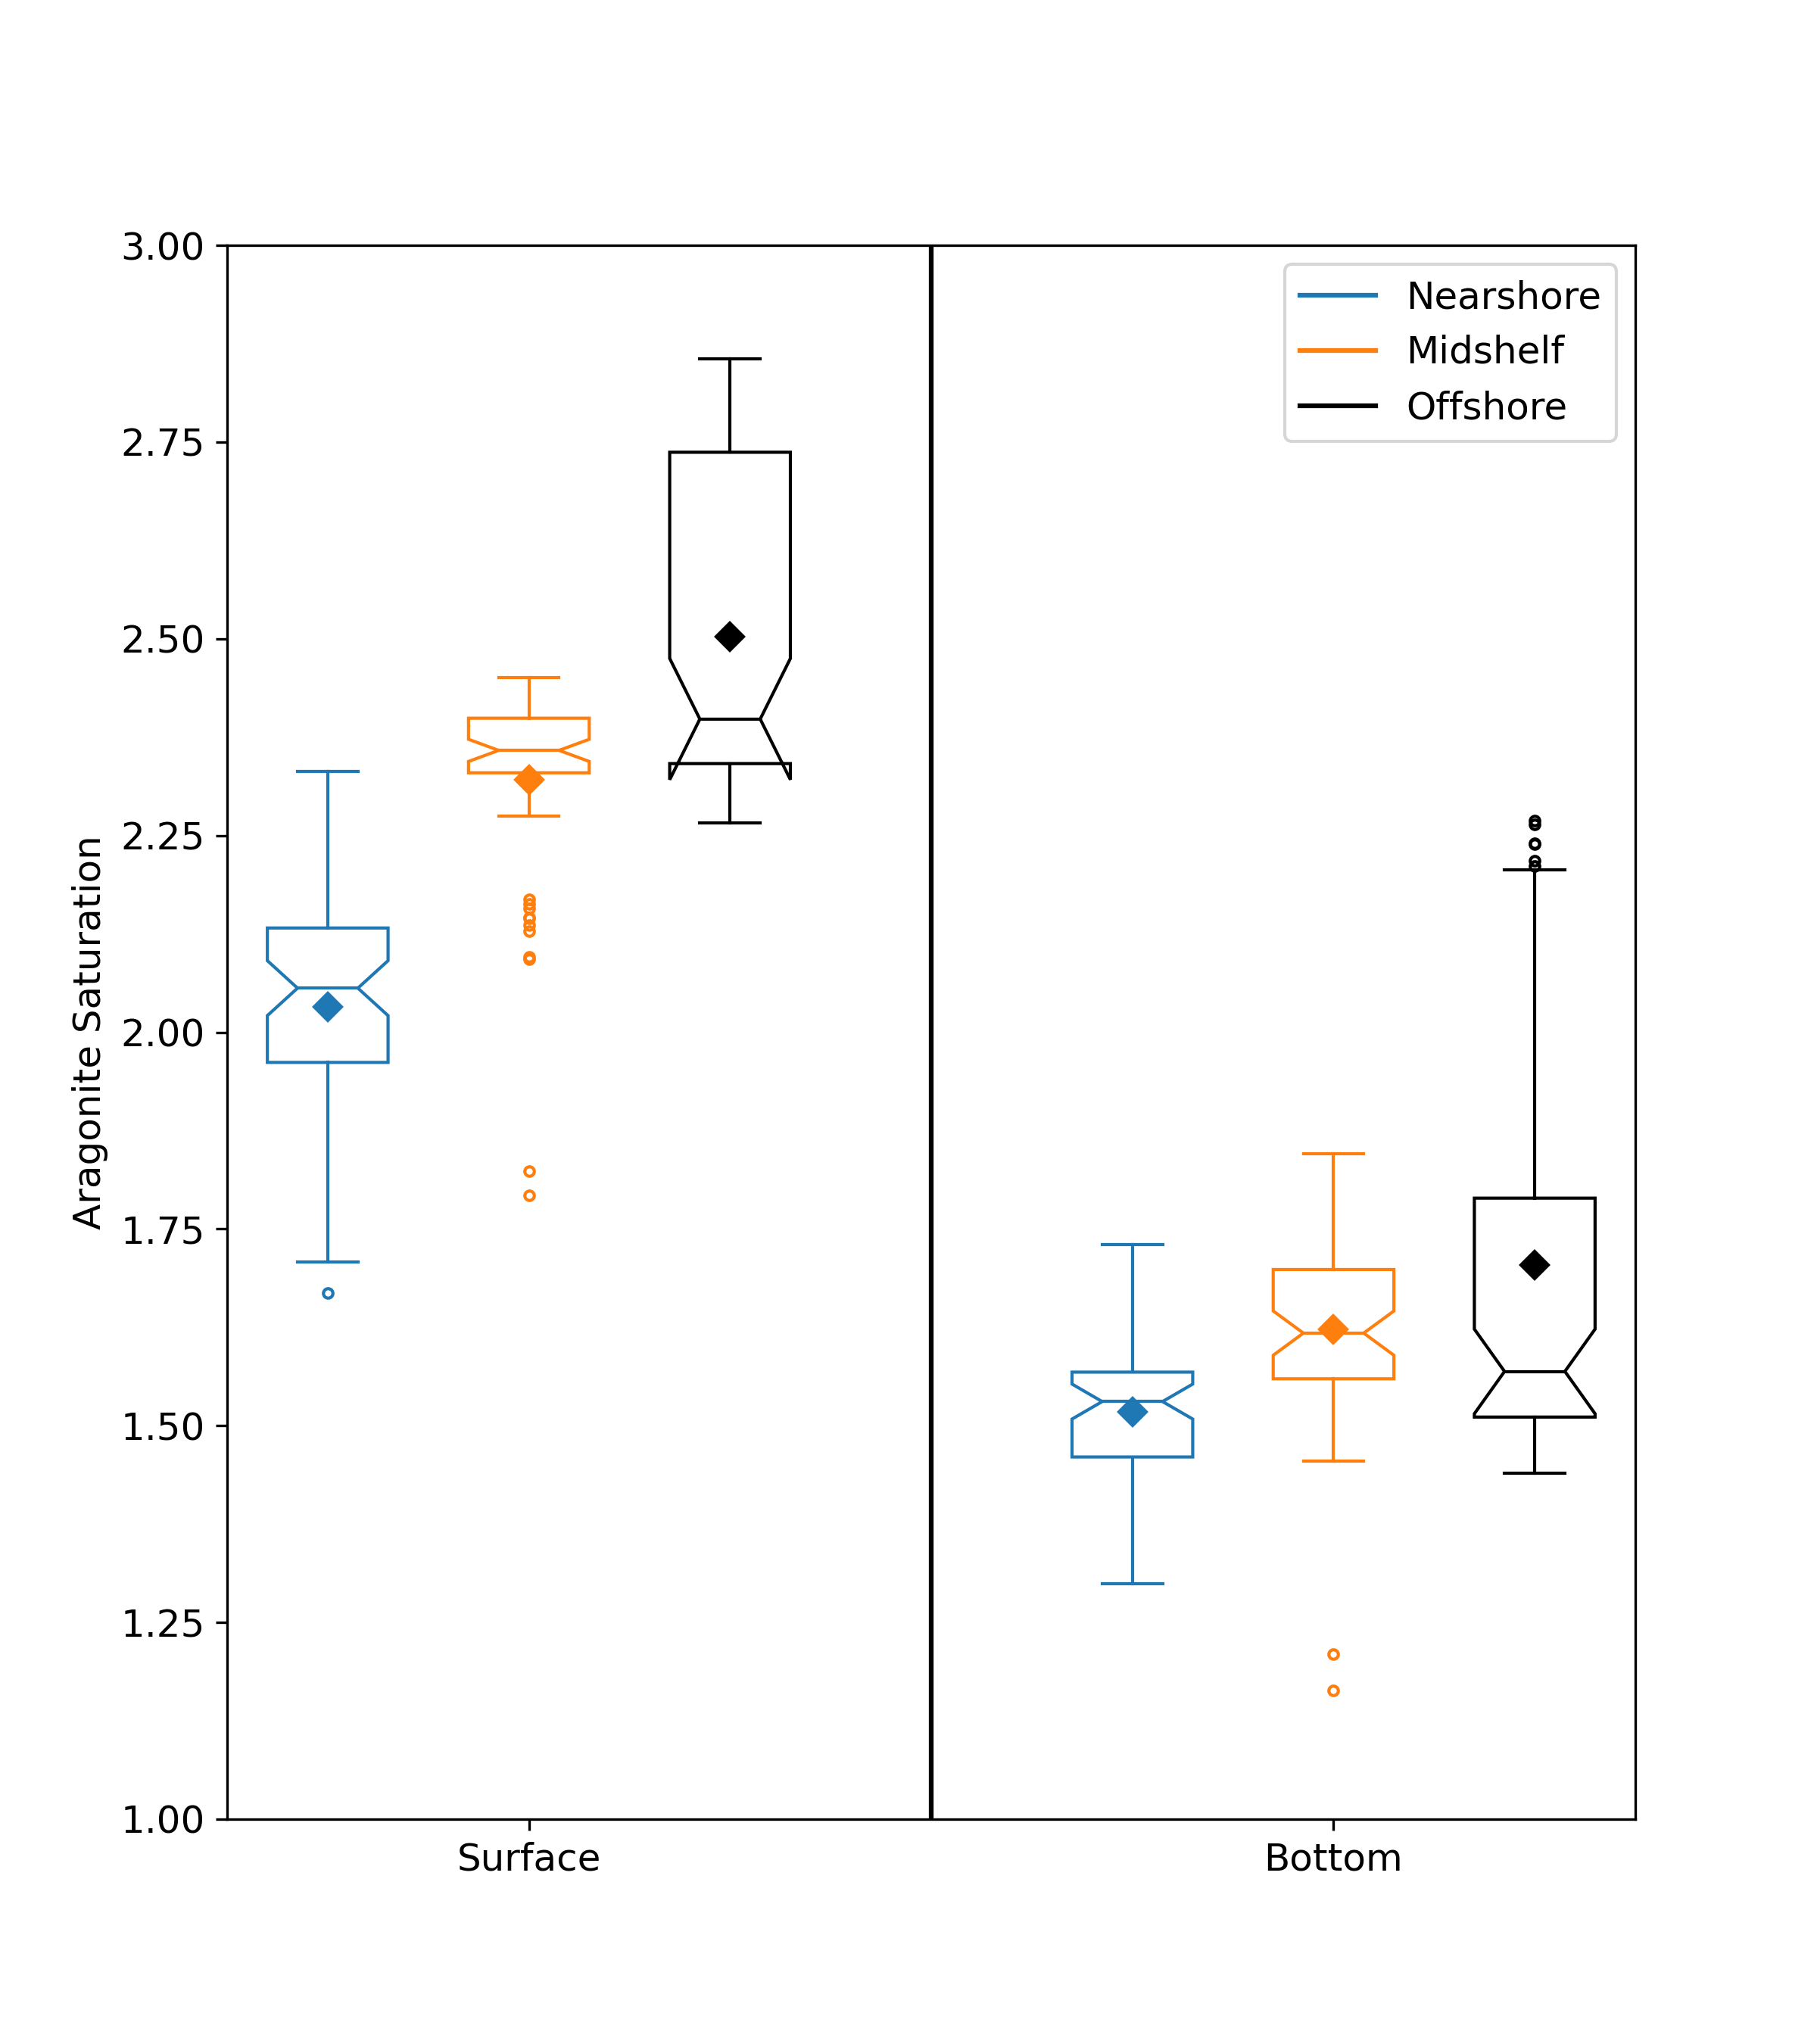
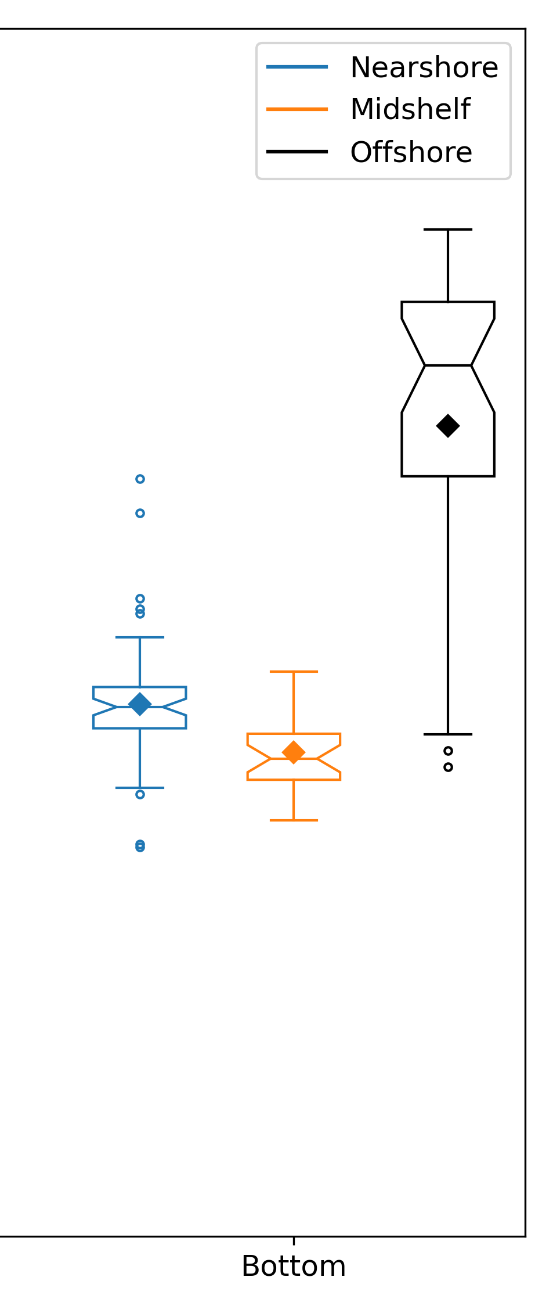
Spatial and Temporal Differences in TA & omega
Nearshore = <40 m
Mid-shelf = 40-60 m
Outer-shelf = >60 m
2019
2021
2019
2021

Slide 19
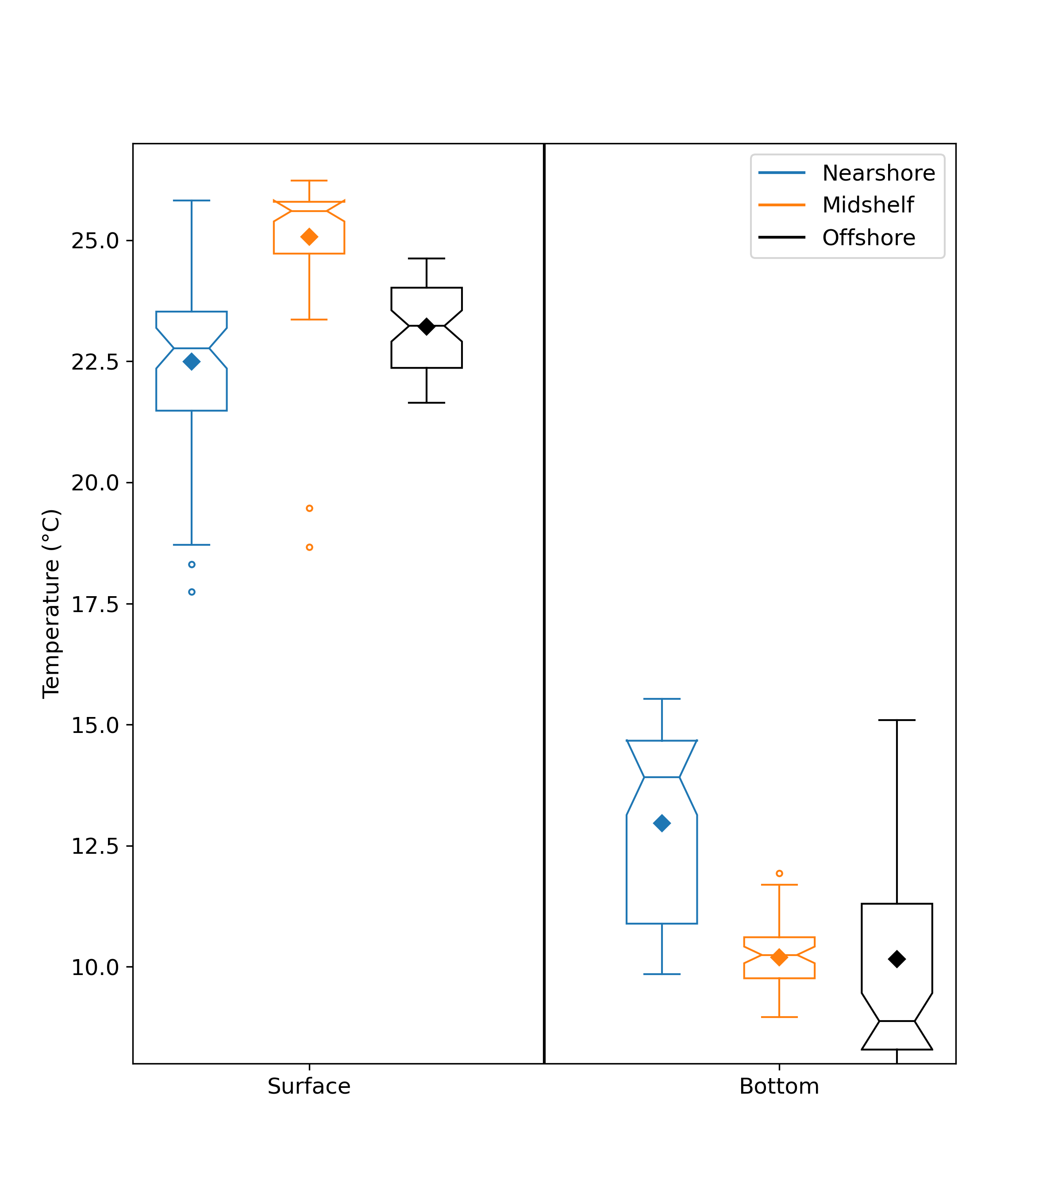
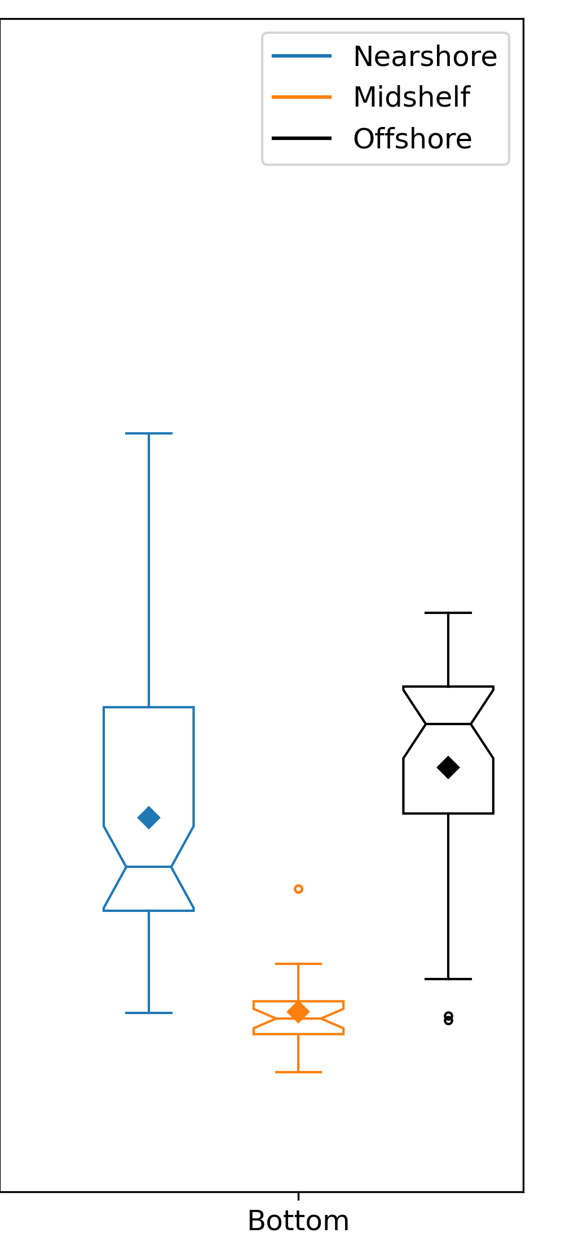
Spatial and Temporal Differences in Temperature
Nearshore = <40 m
Mid-shelf = 40-60 m
Outer-shelf = >60 m
2019
2021
Average bottom temperature in outer-shelf was 10˚ C in 2019 and 15˚ C in 2021, reaching maximum temps of about 17.5˚ C.
These temperatures were at maximum range for optimal growth of Atlantic sea scallops, above range where spawning will occur, and above range where yellowtail flounder occur

Slide 20
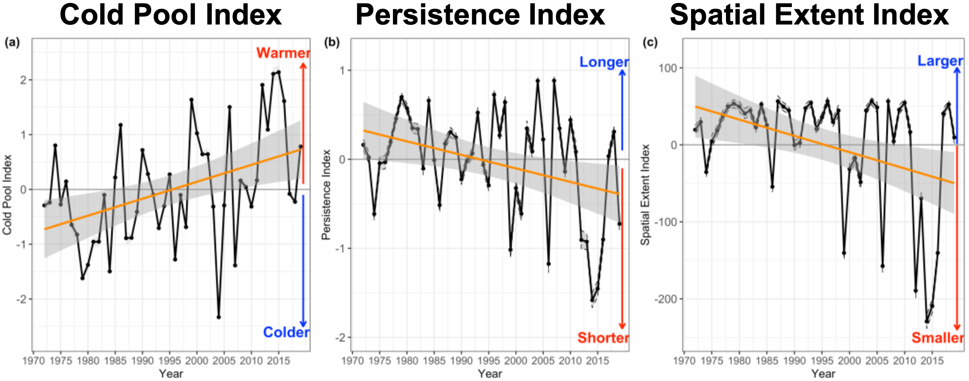
Significance in context to Ongoing and Projected Changes
More WCR activity
More warm, salty intrusions
Cold Pool (1972-2018):
  Warmer
  Shorter
  Smaller
ROMS-NWA + GLORYS12v1 reanalysis
Miller et al. 2016; Chen et al. 2018, 2020, 2021
du Pontavice et al., in revision

Slide 21
Projected warming of the ‘Cold Pool’ and more frequent injections of Gulf Steam-influenced slope water onto the shelf may alleviate ocean acidification, but leave organisms more susceptible to warming

Slide 22
Projected warming of the ‘Cold Pool’ and more frequent injections of Gulf Steam-influenced slope water onto the shelf may alleviate ocean acidification, but leave organisms more susceptible to warming
Research Priority: co-locating biological sampling with future physical and chemical observations of these WCR intrusions to determine how organisms tolerate and respond to the switch in environmental stressors as a result of event-based processes such as this presented here

Slide 23
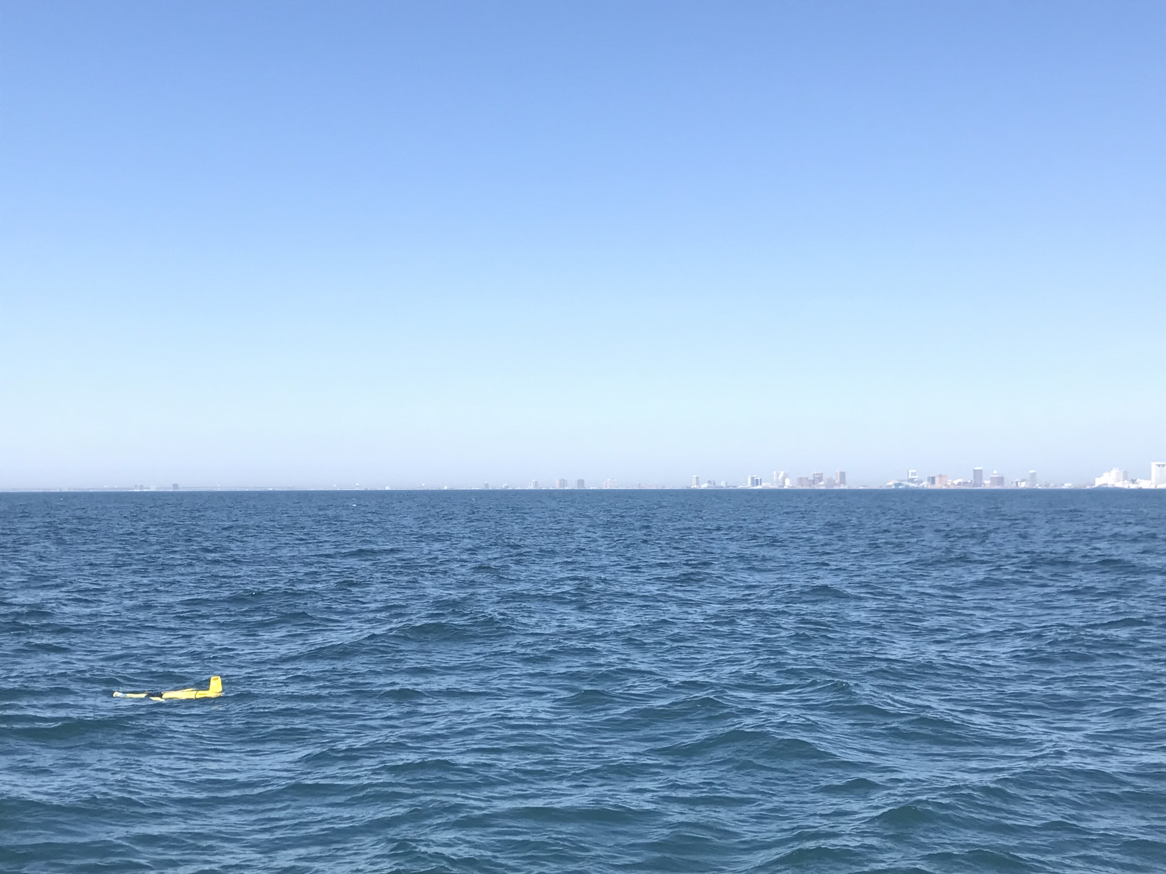


Thanks! saba@marine.rutgers.edu
Special thanks to:
RU glider & software teams
Lori Garzio
David Aragon
Chip Haldeman
Nicole Waite
John Kerfoot
Laura Nazzaro
Liza Wright-Fairbanks
NOAA Ocean Acidification Program
U.S. IOOS
(NA19OAR0170349)

